Slide 1
Playwright Automation using Javascript

Slide 2
disclaimer

Slide 3
Disclaimer
This Training will only cover automation using playwright & Javascript
This training is not intended to teach Javascript, html OR css
We expect attendees should already know about JS, HTML and CSS etc
Non technical people may not gain anything from this training

Slide 4
Disclaimer
We will discuss and do everything from scratch
Its ok & normal if you already know many automation testing concepts
Keep patience if you do not understand any concept, I guarantee you will be able to write test cases using playwright at the end of this course
We will not give emphasis on discussing Javascript / HTML / css logic – more focus on how playwright works

Slide 5
Know your trainer

Slide 6

Know your instructor
Sampurna Atmaramani
Fullstack Dev – Javascript / Typescript
Experience in Development, Management, IT Firm Mgt as well
Currently working on playwright automation
Udemy, TutorialsPoint, Teachable & YouTube Instructor
Medium.com Tech Blogger – more than 90 Articles written till March 2024
https://medium.com/@s.atmaramani

Slide 7
Setting the expectations
After this training, attendees can
Write automation scripts using playwright and manipulate all html & DOM elements (using Javascript)
Can check the reports after test execution
Can automate the web software flow end to end
Can set the CI (Continuous integration) pipeline using github actions

Slide 8
Setting the expectations
There will be quizzes after every section, which attendees must respond
Every trainee must write code and do hands on practice

Slide 9
Contents Generation

Slide 10
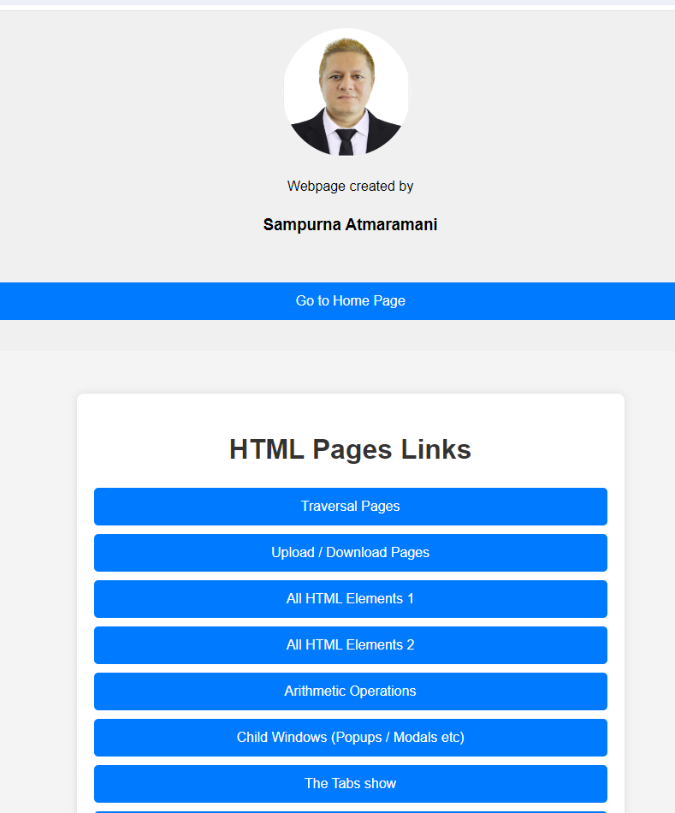
Contents generated from
Own Creations
Wrote Separate Node JS API for proving login scenarios using JWT
Created many HTML pages for explaining various scenarios
Wrote more than 650 test cases only for this training
Resources found from Google / Internet
ChatGPT / Gemini https://playwright.dev Documentation page

Slide 11

Contents

Slide 12
Course Contents
Installing Playwright and related tools i.e. Node, npm, vscode editors etc
Install necessary VS code plugins
Theoretical explanation of the concepts
Practical’s & hands on
Running the tests from various modes (command line, ui, VS code plugins etc)
Using tags to run specific test cases only
Running tests in all or selected browsers

Slide 13
Course Contents
Running whole test file
Running playwright in headed and headless mode (with and without browser)
Running playwright in different viewport like mobile OR IPAD etc

Slide 14
Course Contents
Playwright with various configurable options
From Command Line
From conf file i.e. playwright.config.js
Debugging from command line i.e. –debug
Debugging using page.pause()

Slide 15
Course contents
How to upload and download files using playwright
Intercepting API / URL request & Response
Modifying the request and response i.e. mocking
With one worker and multiple workers (Parallelism)

Slide 16
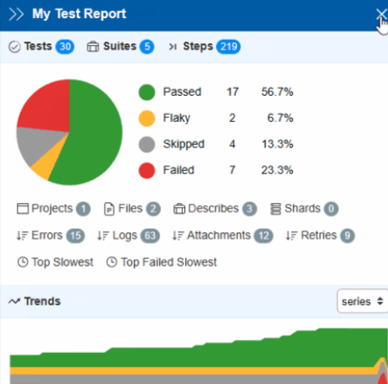
Course contents - reporting
With different type of in built reporting
HTML
JSON
Dot
Line
List

Slide 17
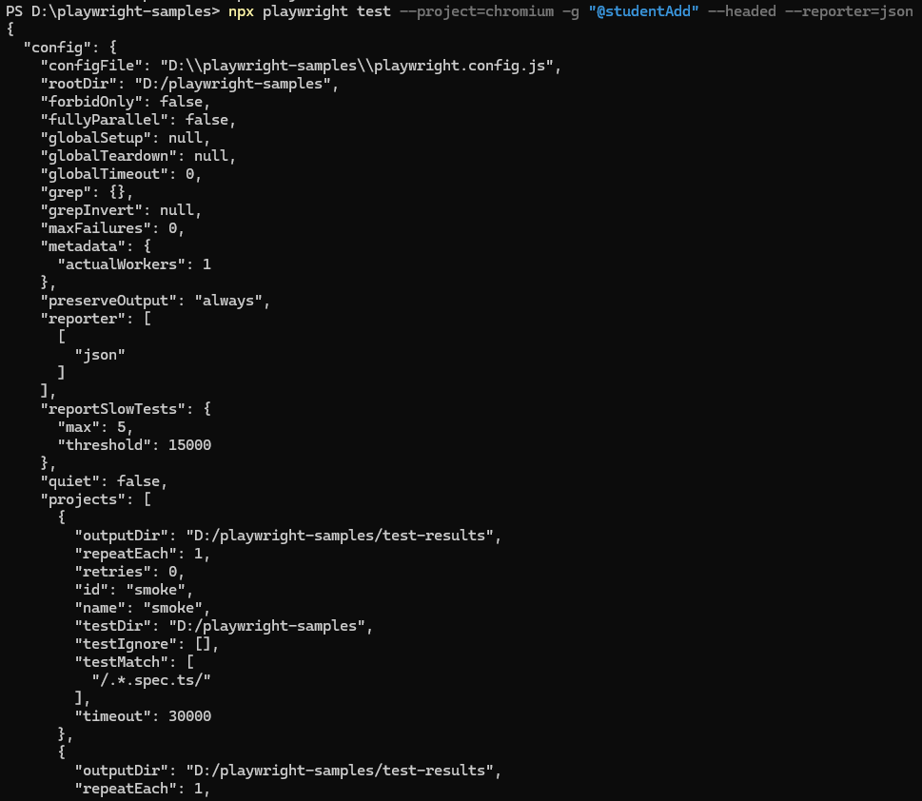

Slide 18
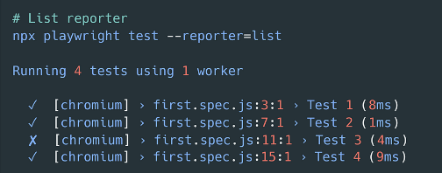
List reporter

Slide 19
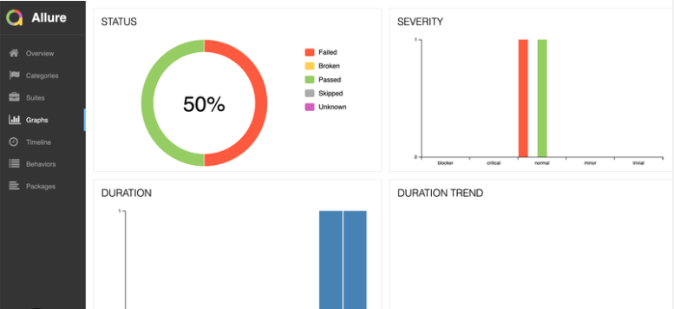
Third Party Reporting
Allure
Argos Visual Testing
Currents
Monocart
ReportPortal
Serenity/JS
Testmo
Testomat.io
Tesults

Slide 20
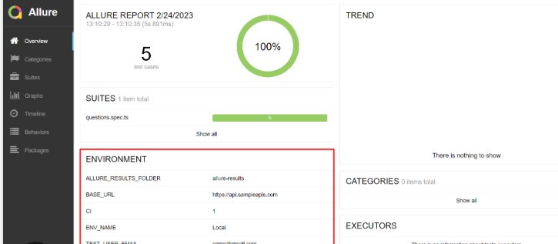
allure

Slide 21
Course contents
Running tests in slow motion
Running tests in trace mode – creates trace.zip
Take screenshots
Record videos
Running in debug mode
Detailed Debugging using Playwright environment variables

Slide 22
Course contents
Interaction with dialog boxes
Alert boxes
Popups / new page opening
Urls opening in new tab, new window even will show hack which will transition from chrome to webkit browser for opening new page
i.e. parent window Chrome
Child window Webkit

Slide 23
Course contents
API Testing
Working with external API using playwright
Getting JWT Token using API request
Handling logged in non logged in users
Restricted page mgt etc

Slide 24
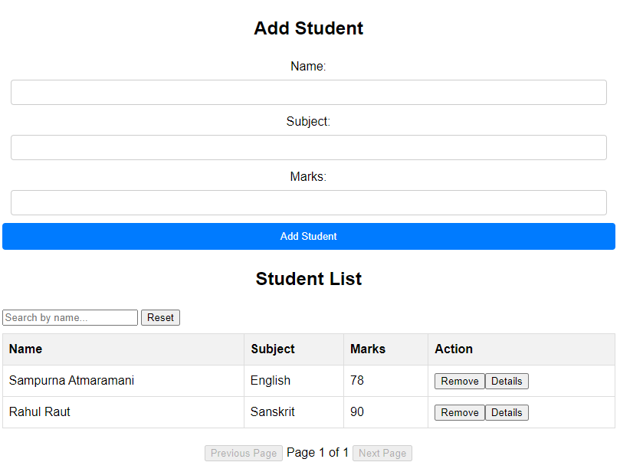
Course contents - Student mgt project
Add student
List student
Search
Pagination (Next and Previous page)
Remove the student record
Display any specific record in alert box
Count number of records
Assertion of everything

Slide 25
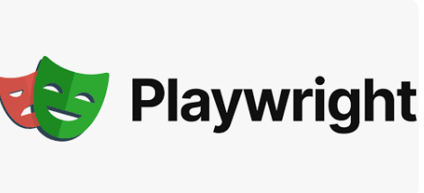
What is playwright

Slide 26
Introduction - Playwright
Playwright is an open-source Node.js library for automating web browsers.
It provides a high-level API for automating actions in Chromium, Firefox, and WebKit browsers.
Playwright supports cross-browser testing, enabling developers to write tests once and run them across multiple browsers.
It offers powerful features such as browser context isolation, automatic waiting, and robust debugging capabilities.
Playwright is developed and maintained by Microsoft,providing comprehensive documentation and active community support.
launched on 31 January 2020 (Just 4 years back)

Slide 27
Playwright
Playwright offers a high-level API for tasks like clicking buttons, filling forms, and navigating pages.
Playwright is widely used for web testing, web scraping, and browser automation tasks.

Slide 28


Comparision

Slide 29
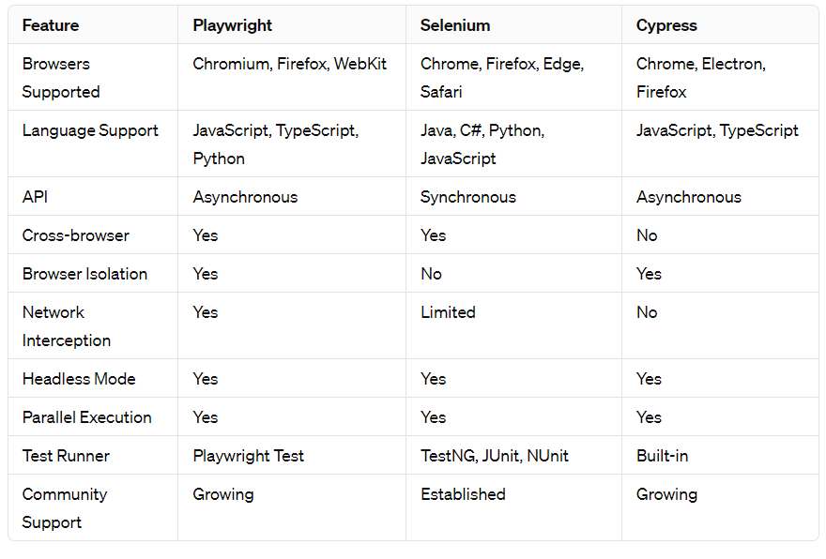
Comparision – Playwright /Selenium / Cypress

Slide 30
Features
Cross-Browser Support: Playwright supports multiple browsers, including Chromium, Firefox, and WebKit, ensuring comprehensive browser coverage for testing.
Unified API: It offers a unified API for automating web interactions across different browsers, making it easy to write and maintain tests without needing to learn multiple APIs.
Browser Isolation: Playwright provides browser isolation, allowing tests to run in separate browser instances to prevent interference between tests and ensure reliable results.
Network Interception: With built-in support for network interception, Playwright enables developers to mock network requests, intercept responses, and simulate various network conditions during testing.

Slide 31
Playwright Features
Headless and Headful Mode: It supports both headless and headful modes, allowing tests to run in the background (headless) or with a visible browser window (headful), depending on the testing requirements.
Parallel Execution: Playwright enables parallel execution of tests across multiple browsers and devices, optimizing test execution time and improving overall efficiency.
DevTools Integration: It offers seamless integration with browser DevTools, allowing developers to debug and inspect test execution, analyze performance metrics, and troubleshoot issues effectively.
Community and Ecosystem: Playwright boasts a growing community of developers and contributors, along with an expanding ecosystem of plugins, integrations, and resources to support testing needs.

Slide 32

Quiz Time

Slide 33
Quiz
True OR false :- Playwright allows third party reporting
True
True or False :- Its not possible to take screenshots in Playwright
False
True of False :- Playwright have Electron browser also in built
False

Slide 34
Quiz
True OR false :- Playwright has different API’s for all 3 different browsers
False
True or False :- Playwright runs on only Headed mode (always opens browser)
False
True of False :- We can intercept Network request and response using Playwright
True

Slide 35
Installation

Slide 36
Installation
Install node JS
Install NPM
Install Playwright –> npm install playwright
Create new project
npm init –y
Install any editor, preferably VS Code

Slide 37
Version Check and Upgrade
npx playwright –version
npm install -D @playwright/test@latest
# Also download new browser binaries and their dependencies: npx playwright install --with-deps

Slide 38
System requirements​
Node.js 18+
Windows 10+, Windows Server 2016+ or Windows Subsystem for Linux (WSL).
MacOS 12 Monterey, MacOS 13 Ventura, or MacOS 14 Sonoma.
Debian 11, Debian 12, Ubuntu 20.04 or Ubuntu 22.04, with x86-64 or arm64 architecture.

Slide 39
Test Objects & Utilities

Slide 40
Objects & Utilities
The @playwright/test package provides several utilities and objects that you can use to write and organize your tests effectively.
ex. const {test, expect} = require(“@playwright/test”);
test: The test function is used to define individual test cases.
expect: The expect function is used for assertions within test cases.

Slide 41
Objects & Utilities
beforeEach: The beforeEach hook is used to run setup code before each test case.
Ex. launching the browser
afterEach: The afterEach hook is used to run teardown code after each test case.
Ex. clean up the test environment
describe: The describe function is used to group related test cases together.
context: The context object provides information about the current test context, including the browser instance and the current page.

Slide 42
Objects & Utilities
beforeAll: The beforeAll hook is used to run setup code once before all test cases. It's often used for expensive operations that only need to be performed once, such as launching the browser or setting up test data.
afterAll: The afterAll hook is used to run teardown code once after all test cases. It's often used to clean up resources that were set up in the beforeAll hook.

Slide 43
locator

Slide 44
What is Locator
A locator in Playwright is a mechanism used to find and interact with elements on a web page.
It helps identify elements based on different attributes like CSS selectors, XPath expressions, text content, or other properties.
CSS Selector for <button class="submitClass“ id=“submitID”>Submit</button>
Syntax: page.locator(selector)
Example: page.locator('button. submitClass’) OR page.locator('button#submitID ‘) OR
Page.locator(“#submitID”)

Slide 45
XPath Expression:
<input type="text" id="username" name=“nameUser" placeholder="Enter your username">
Syntax:
page.locator('your_xpath_expression' )
Example:
page.locator('//input[@id="username"]’ )
Page.locator(“//input[@name= nameUser’]”);

Slide 46
CSs Selectors
CSS Selectors: CSS selectors are patterns used to select the elements you want to style on a web page. They can target elements based on their type, class, ID, or relationship with other elements.
div: Selects all <div> elements.
.classname: Selects all elements with the specified class.
#id: Selects the element with the specified ID.
element1 element2: Selects all element2 elements inside element1.

Slide 47
Text Content:
<button>Submit</button>
Syntax: page.locator('text=Your Text')
Example: page.locator('text=Submit')

Slide 48
Attribute Value:
Attribute Selectors: Attribute selectors allow you to select elements based on the presence or value of their attributes.
<input type="text" name="username" placeholder="Enter your username">
Syntax: page.locator('[attribute="value"]')
Example: page.locator('[name="username"]')

Slide 49
Attribute selection
[name]: Selects all elements with a name attribute.
[name="value"]: Selects all elements with a name attribute equal to 'value'.
[name^="value"]: Selects all elements with a name attribute starting with 'value'.
[name$="value"]: Selects all elements with a name attribute ending with 'value'.
[name*="value"]: Selects all elements with a name attribute containing 'value' anywhere within the attribute value.

Slide 50
Page.$ and page.$$
page.$() and page.$$() are functions used to find elements within the current page context.
They are similar to document.querySelector() and document.querySelectorAll() in the browser's JavaScript environment.
Page.$ and page.$$ is same as page.locator
page.$(“#userid”) => returns one element or null if not found (in case of multiple elements, then returns only first element)
page.$$(“.userClass”) => returns all elements in array format Or empty array if not found

Slide 51
Code Examples
Page.$ example
npx playwright test --project=chromium -g "@page.singledollar" --headed
Page.$$ example
npx playwright test --project=chromium -g "@page.doubledollar1" --headed
npx playwright test --project=chromium -g "@page.doubledollar2" --headed

Slide 52
Chaining – first, last, nth

Slide 53
Chaining – first, last, nth
<input type="text" name="username" placeholder="Enter your username">
<input type="text" name="username" placeholder="Enter your username">
<input type="text" name="username" placeholder="Enter your username">
<input type="text" name="username" placeholder="Enter your username">
const firstInput = page.locator('input[name="username"]').first();
const lastInput = page.locator('input[name="username"]').last();
const secondInput = page.locator('input[name="username"]').nth(2); //starts from 0
npx playwright test --project=chromium -g "@chaining" --headed

Slide 54
Basic Commands

Slide 55
Basic Commands
npx playwright init:
Initializes a new Playwright project in the current directory.
npx playwright codegen <URL>: OR npx playwright codegen
Generates code snippets based on interactions with a web page.
npx playwright install:
Installs dependencies required for Playwright projects.

Slide 56
Commands
npx playwright test:
Runs tests using Playwright.
npx playwright show-report:
Opens the HTML report of test results in the default browser.
6. npx playwright test –ui
Run your tests with UI Mode for a better developer experience with time travel debugging, watch mode and more.

Slide 57
Basic Commands
npx playwright test –debug (dash dash debug)
Opens playwright tests in debug mode
npx playwright test –project=chromium –workers=2
Opens playwright tests on chrome browser with 2 workers (parallel testing & Fast Execution)
npx playwright test --project=chromium -g "@recordvideo" --headed --workers=2
Start playwright tests with trace mode on , only run tests having tags as @recordvideo

Slide 58
Quiz Time

Slide 59
Quiz
True or False :- chaining starts from 1 (number one)
False
True of False :- We need to compulsorily run our code on all the available browsers
False
True OR false :- We can do tagging and run only selected test cases
True

Slide 60
Files structure
After installation

Slide 61
Installed files & Folders
playwright.config.js package.json package-lock.json tests/ example.spec.js tests-examples/ demo-todo-app.spec.js

Slide 62
Hands On
1. Create a Test File:
Create a new file for your test script.
For example, you can name it firstTest.spec.js
2. Write Your Test:
Inside the test file, import the necessary functions and objects from Playwright and write your test logic.
Here's an example of a simple test that navigates to a web page and verifies the page title:

Slide 63
Sample First test script
const { test, expect } = require('@playwright/test');
test('My First Test', async ({ page }) => {
await page.goto('https://example.com');
expect(await page.title()).toBe('Example Domain’);
OR
await expect(page).toHaveTitle('Example Domain’);
});
Run the above script
npx playwright test tests/firstTest.spec.js

Slide 64
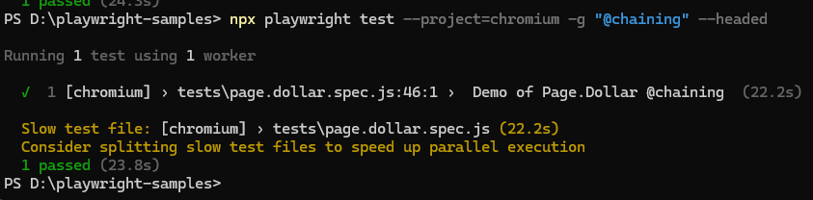
Review the Results: After running the test, you'll see the test results in the terminal.
Playwright will indicate whether the test passed or failed, along with any relevant information or error messages.

Slide 65
Test Case structure

Slide 66
Important Blocks
Setup Block:
Action Block:
Assertion Block:
Cleanup Block:
Teardown Block

Slide 67
Setup Block
This block is where you set up the test environment, including initializing resources, configuring the test environment, and preparing the system under test (SUT) for testing.
Example tasks:
Launching the browser.
Opening a new page.
Setting up test data.
Navigating to a specific URL.

Slide 68
Action Block:
This block contains the actions or operations that you perform on the SUT during the test.
Example tasks:
Clicking on elements.
Filling in forms.
Interacting with UI components.
Making API requests.

Slide 69
Assertion Block:
This block contains the assertions or checks that verify whether the test behaves as expected.
Example tasks:
Verifying text content.
Checking element visibility.
Asserting element attributes.
Validating API responses.

Slide 70
Cleanup Block:
This block is responsible for cleaning up the test environment and resources after the test completes, ensuring that the system is left in a consistent state.
Example tasks:
Closing the browser.
Resetting test data.
Releasing resources.
Logging test results.

Slide 71
Teardown Block (Optional):
Playwright provide a teardown block, which is executed after each test case or test suite, regardless of whether the test passed or failed. It's typically used for additional cleanup tasks.
Example tasks:
Closing database connections.
Resetting global state.
Performing additional cleanup actions.

Slide 72
Test script structure
In a basic test script using Playwright, you can expect to find the following elements:
Imports: Import necessary functions and objects from Playwright or other libraries.
const { test, expect } = require('@playwright/test');

Slide 73
Test Declaration
Define your test cases using the test function provided by Playwright.
test('Test Description', async ({ page }) => {
// Test logic goes here
});

Slide 74
Test Logic
Write the logic for your test case inside the test function. This may include navigating to web pages, interacting with elements, making assertions, etc.
test('Login Test', async ({ page }) => {
await page.goto('https://example.com');
// Perform login actions
// Assert login success
});

Slide 75
Assertions
Use the expect function to make assertions about the behavior of your application.
test('Login Test', async ({ page }) => {
await page.goto('https://example.com');
const pageTitle = await page.title();
expect(pageTitle).toBe('Example Domain');
});

Slide 76
Hooks Setup and Teardown
Optionally, you can include setup and teardown logic before and after each test case using beforeEach and afterEach hooks.
beforeEach(async ({ page }) => {
// Setup logic goes here
});
afterEach(async ({ page }) => {
// Teardown logic goes here
});

Slide 77
Environment configuration

Slide 78
Environment Configuration
You may configure the test environment, such as browser settings, geolocation, locale, viewport size, etc.
use({
...devices['iPhone 12 Pro Max'],
locale: 'en-US',
geolocation: { longitude: 10.0, latitude: 20.0 },
});

Slide 79
NAvigation

Slide 80
navigation
Most of the UI tests will start with navigating page to the URL
await page.goto(<URL>);
await page.goto('https://playwright.dev/’);

Slide 81
Interactions

Slide 82
Interactions
Performing actions starts with locating the elements.
Playwright uses Locators API for that. Locators represent a way to find element(s) on the page at any moment
<a href=“google.com”>Get started</a>
// Create a locator. const getStarted = page.getByRole('link', { name: 'Get started' }); // Click it. await getStarted.click();

Slide 83
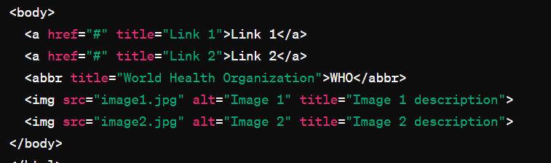
Get By ….
getByRole: Finds an element based on its role attribute, such as "button" or "link".
getByText: Finds an element containing the specified text.
getByTestId: Finds an element by its data-testid attribute.
getByTitle: Finds an element by its title attribute.
getByAltText: Finds an element by its alt attribute, commonly used for images.

Slide 84
Basic actions
Action | Description
locator.check() | Check the input checkbox
locator.click() | Click the element
locator.uncheck() | Uncheck the input checkbox
locator.hover() | Hover mouse over the element
locator.fill() | Fill the form field, input text
locator.focus() | Focus the element
locator.press() | Press single key
locator.setInputFiles() | Pick files to upload
locator.selectOption() | Select option in the drop down

Slide 85
Actionability Checks
Playwright smartly perform checks these before taking action

Slide 86
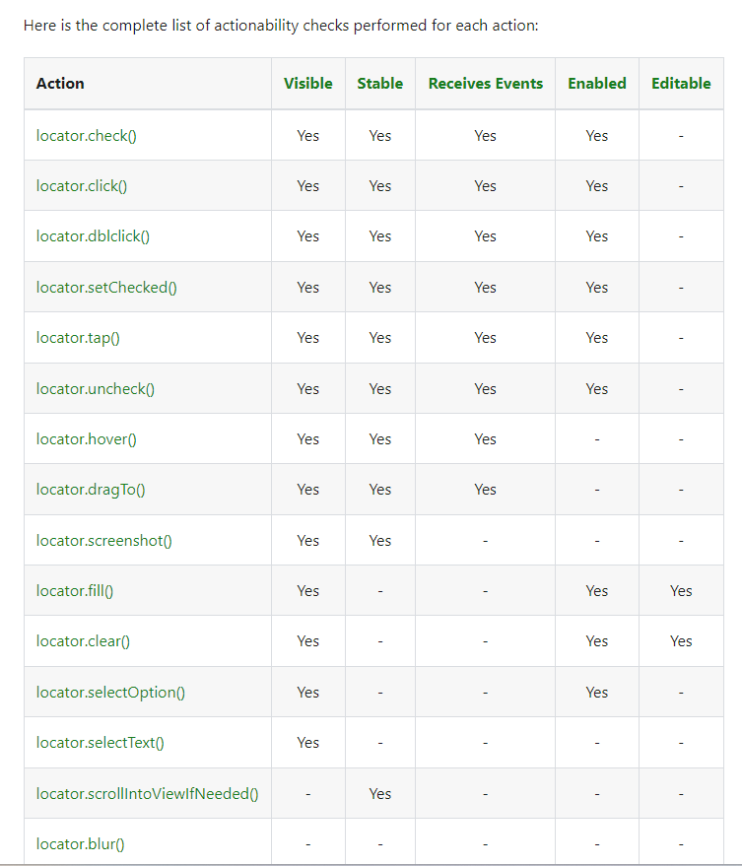

Slide 87
assertions

Slide 88
Assertions
expect(success).toBeTruthy();
await expect(page).toHaveTitle(“Playwright”);
OR
await expect(page.title()).toBe(“Playwright”);

Slide 89
assertions
Assertion | Description
expect(locator).toBeChecked() | Checkbox is checked
expect(locator).toBeEnabled() | Control is enabled
expect(locator).toBeVisible() | Element is visible
expect(locator).toContainText() | Element contains text
expect(locator).toHaveAttribute() | Element has attribute
expect(locator).toHaveCount() | List of elements has given length
expect(locator).toHaveText() | Element matches text
expect(locator).toHaveValue() | Input element has value
expect(page).toHaveTitle() | Page has title
expect(page).toHaveURL() | Page has URL

Slide 90
Test ISOlation

Slide 91
Test Isolation
Pages are isolated between tests due to the Browser Context, which is equivalent to a brand new browser profile, where every test gets a fresh environment, even when multiple tests run in a single Browser.
This isolation between tests provides several benefits, including:
Improved reliability: Each test runs in a clean environment, reducing the likelihood of interference from external factors or dependencies.
Parallel execution: Tests can be executed in parallel, as they do not depend on shared resources or state.
Clear separation of concerns: Each test case is self-contained and independent, making it easier to understand and maintain the test suite.

Slide 92
One file, multiple browser instances
import { test } from '@playwright/test'; test('example test', async ({ page }) => { // "page" belongs to an isolated BrowserContext, created for this specific test. });
//This should open another browser with fresh start test('another test', async ({ page }) => { // "page" in this second test is completely isolated from the first test. });

Slide 93
Hooks

Slide 94
Hooks
You can use various test hooks such as test.describe to declare a group of tests and test.beforeEach and test.afterEach which are executed before/after each test.
Other hooks include the test.beforeAll and test.afterAll which are executed once per worker before/after all tests.

Slide 95
Hooks
test.describe('navigation', () => { test.beforeEach(async ({ page }) => { // Go to the starting url before each test. await page.goto('https://playwright.dev/’);
}) test('main navigation', async ({ page }) => { // Assertions use the expect API. await expect(page).toHaveURL('https://playwright.dev/’); }); });
});

Slide 96
Hooks
Hooks in Playwright are functions that allow you to perform setup and teardown actions before and after test cases or test suites.
beforeAll: This hook runs once before all test cases in a test suite. It is typically used for global setup tasks that need to be performed once before any tests are executed.
beforeEach: This hook runs before each individual test case in a test suite. It is commonly used to set up a clean test environment or perform initialization steps specific to each test.

Slide 97
Hooks
afterEach: This hook runs after each individual test case in a test suite. It is used to clean up resources or perform teardown actions that are needed after each test.
afterAll: This hook runs once after all test cases in a test suite have been executed. It is used for global teardown tasks or cleanup actions that need to be performed once after all tests have finished.

Slide 98
Quiz Time

Slide 99
Quiz
Question: What is the purpose of the page.goto function in a test script?
Answer: The page.goto function navigates the browser to a specified URL, allowing us to start our test from a specific web page.

Slide 100
Quiz
Question: How do you make assertions about the behavior of your application in a Playwright test script?
Answer: expect

Slide 101
Quiz
Question: What is the purpose of the beforeEach and afterEach hooks in a Playwright test script?
Answer: These hooks allow you to execute setup and teardown logic before and after each test case, ensuring a clean and consistent test environment.

Slide 102
Quiz
Question: Give me a command to execute a Playwright test script using the Playwright CLI (Command Line)
Answer: npx playwright test

Slide 103
Playwright API

Slide 104
Playwright API
The Playwright API provides a comprehensive set of functionalities for automating browser interactions. Here's an overview of some key features:
Browser Management: Playwright allows you to launch and manage browser instances programmatically. You can control various browser options such as headless mode, viewport size, user agent, and more.
Page Navigation: With Playwright, you can navigate through web pages by loading URLs, clicking on links, filling out forms, and interacting with various elements such as buttons, inputs, and dropdowns.
Element Selection and Interaction: Playwright provides methods to locate and interact with HTML elements on the page. You can find elements by CSS selectors, XPath expressions, or using other attributes. Once located, you can interact with elements by clicking, typing text, hovering, or performing other actions.

Slide 105
Playwright API
Keyboard and Mouse Actions: Playwright allows you to simulate keyboard and mouse actions, such as typing text, pressing keys, moving the mouse cursor, and performing drag-and-drop operations.
Assertions and Expectations: Playwright includes built-in assertion methods for verifying the state of the web page during test execution. You can check element visibility, text content, attribute values, and more to ensure that your application behaves as expected.
Intercepting Network Requests: Playwright enables you to intercept and modify network requests and responses. This feature is useful for testing applications that rely on APIs or backend services, allowing you to mock responses, simulate network conditions, or capture network activity for analysis.
Browser Contexts and Cookies: Playwright supports multiple browser contexts, allowing you to isolate cookies, caches, and other browser state between different test scenarios. This feature is helpful for testing user authentication, session management, and other scenarios where maintaining separate browser contexts is necessary.

Slide 106
Playwright API
Screenshots and Videos: Playwright provides APIs for capturing screenshots and recording videos of test executions. You can use these features to create visual documentation, debug failing tests, or share test results with stakeholders.
Error Handling and Debugging: Playwright offers robust error handling mechanisms and debugging tools to help you diagnose and troubleshoot issues in your test scripts. You can log messages, handle exceptions, and inspect browser console output to identify problems and optimize test performance.
Integration with Testing Frameworks: Playwright integrates seamlessly with popular testing frameworks such as Jest, Mocha, and Jasmine. You can write and execute Playwright tests within your existing test suites, leveraging the features and capabilities of your preferred testing framework.

Slide 107
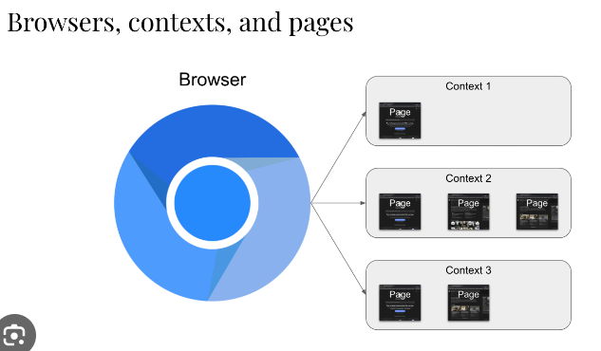
Representation

Slide 108
Browser Context
A browser context represents an isolated browsing session within a browser instance.
Each browser context has its own set of cookies, local storage, caches, and other browser state.
Browser contexts are useful for simulating different user scenarios or testing authentication mechanisms.
You can create multiple browser contexts within a single browser instance to run parallel tests or handle different user sessions separately.

Slide 109
Pages

Slide 110
Pages
A page is a single tab or window within a browser context that displays a web page.
You can interact with pages to navigate to URLs, interact with elements, and perform various actions.
Pages expose methods for interacting with the DOM, including clicking elements, typing text, and evaluating JavaScript expressions.
Playwright provides APIs for creating, closing, and managing pages within browser contexts dynamically.

Slide 111
Elements

Slide 112
Elements
Elements represent individual HTML elements on a web page, such as buttons, inputs, or divs.
You can locate elements using CSS selectors, XPath expressions, or other attributes.
Once located, elements provide methods for interacting with them, such as clicking, typing text, or retrieving attribute values.

Slide 113
Navigation Methods

Slide 114
Navigation Methods:
Playwright provides several methods for navigating between pages:
page.goto(url): Navigates to the specified URL. You can optionally provide navigation options such as timeout, waitUntil, and referer.
page.goBack(): Navigates to the previous page in the browser history.
page.goForward(): Navigates to the next page in the browser history.
page.reload(): Reloads the current page.

Slide 115
Navigation events

Slide 116
Navigation Events
Playwright emits various navigation-related events that you can listen for and handle in your tests:
page.on('navigation', handlerFn): Fired when the page navigates to a new URL.
page.on('load', handlerFn): Fired when the page's load event is triggered, indicating that all resources have finished loading.
page.on('domcontentloaded', handlerFn): Fired when the DOM content of the page is fully loaded, but not necessarily all resources like images or scripts.
page.on('frameattached', handlerFn): Fired when a new frame is attached to the page.

Slide 117
Navigation control

Slide 118
Navigation Control:
You can control navigation behavior using various options and settings:
Timeout : Specifies the maximum time to wait for navigation to complete before throwing an error.
Maximum operation time in milliseconds. Defaults to 0 - no timeout
waitUntil : Defines when to consider navigation successful, such as when the page's load event fires or when the DOM content is loaded.
waitUntil "load"|"domcontentloaded"|"networkidle"|"commit" (optional)#
referer: Sets the Referer HTTP header for the navigation request.

Slide 119
Navigating to URLs & Waiting

Slide 120
Navigating to URLs:
Playwright allows you to navigate to specific URLs using the page.goto(url[, options]) method. You can provide the URL as the first argument and optionally specify navigation options such as timeout, waitUntil, and referer.
Waiting for Navigation:
After initiating a navigation, you can wait for the page to complete loading using the page. page.waitForURL([options]) method. This method allows you to wait until the navigation is complete, and the page has stabilized before proceeding with further actions.

Slide 121
Waiting for Page content
Sometimes, you may need to wait for specific content to appear on the page before continuing with your tests. Playwright provides methods like page.waitForSelector(selector[, options]) and page.waitForFunction(predicate[, options]) to wait for elements or conditions to become visible or satisfied.
Handling Navigation Events:
Playwright emits various navigation-related events that you can listen for and handle in your tests. For example, you can use the page.on('load', handler) event to detect when the page's load event is triggered, indicating that all resources have finished loading.
Reload and Navigation History:
Playwright also allows you to reload the current page using the page.reload([options]) method. Additionally, you can navigate backward and forward in the browser's navigation history using the page.goBack([options]) and page.goForward([options]) methods, respectively.

Slide 122
Listening to events

Slide 123
Listening to Navigation Events:
Playwright provides the page.on(event, handler) method to listen for navigation events. You can use this method to register event listeners for events such as load, domcontentloaded, error, framenavigated, etc.
// Listen for the 'load' event
page.on('load', () => {
console.log('Page loaded successfully');
});

Slide 124
domcontentloaded
// Listen for the 'domcontentloaded' event
page.on('domcontentloaded', () => {
console.log('DOM content loaded');
});

Slide 125
error
// Listen for the 'error' event
page.on('error', (err) => {
console.error('Navigation error:', err);
});

Slide 126
framenavigated
// Listen for the 'framenavigated' event
page.on('framenavigated', (frame) => {
console.log('Frame navigated:', frame.url());
});

Slide 127
Handling Page Load:
You can use the 'load' event to determine when the page has finished loading.
This event is triggered when the load event of the page is fired, indicating that all resources (including stylesheets, images, and scripts) have been loaded.

Slide 128
Handling DOM Content Loaded:
The 'domcontentloaded' event occurs when the initial HTML document has been completely loaded and parsed, without waiting for stylesheets, images, and subframes to finish loading.

Slide 129
Handling Errors:
The 'error' event is triggered when an error occurs during navigation, such as a network error or a page load timeout.
You can use this event to handle navigation failures gracefully.

Slide 130
Handling Frame Navigation:
Playwright also emits the 'framenavigated' event whenever a frame within the page is navigated to a new URL.
This allows you to track changes in the page's frame structure.

Slide 131
Waiting for element

Slide 132
Waiting for Element Availability:
Use waitForSelector() to wait for an element to appear, be visible, or reach a specific state before interacting with it. This helps handle dynamic content loading and ensures element availability.
<button class=‘someclass”>Submit</button>
Page.waitForSelector(“.someclass”).click();

Slide 133
await page.goto('https://example.com');
const element = await page.waitForSelector('h1');
console.log('Element found:', element);

Slide 134
Retrieving info

Slide 135
Retrieving Element Properties:
You can retrieve various properties of an element, such as its text content, attributes, visibility status, bounding box, etc., using methods like innerText(), getAttribute(name), isVisible() etc.
await page.goto('https://example.com’);
const element = await page.$(‘.textInput’);
const textContent = await element.textContent();

Slide 136
Retriving info
const element = await page.$('a’);
const hrefAttributeValue = await element.getAttribute('href’);
console.log('Href Attribute Value:', hrefAttributeValue);

Slide 137
Element state

Slide 138
Handling Element State:
Playwright provides methods to check and modify the state of elements, such as isChecked() and setChecked() for checkboxes, isSelected() and selectOption() for dropdowns, etc.

Slide 139
Clicking on elements

Slide 140
Clicking on Elements:
Use the click() method to simulate a mouse click on an element.
Option 1
await page.click(‘#button'); // Clicks a button having id=button
Option 2
Await page.locator(“#button”).click()

Slide 141
Insert text

Slide 142
Typing Text:
Use the fill(text) method to simulate typing text into input fields, text areas, or other editable elements.
await page.fill('input[type="text"]', 'Hello, World!'); // Types text into a text input field
Await page.fill(“#username”, “Some Value”);
Await page.locator(“#username”).fill(“Some Value here”);

Slide 143
Hover

Slide 144
Hovering Over Elements:
Use the hover() method to simulate hovering over an element. This can trigger hover-related effects like dropdown menus.
await page.hover('a.dropdown-toggle'); // Hovers over a dropdown menu trigger

Slide 145
checkboxes

Slide 146
Interacting with Checkboxes and Radio Buttons:
Use methods like check() and uncheck() to interact with checkboxes, and radioButton.click() to interact with radio buttons.
await page.check('input[type="checkbox"]'); // Checks a checkbox
await page.uncheck('input[type="checkbox"]'); // Unchecks a checkbox
Await page.locator(“someLocator”).check();

Slide 147
selecting dropdown option

Slide 148
Selecting Options in Dropdowns:
Use the selectOption() method to select an option in a dropdown menu.
await page.selectOption('select#dropdown', 'Option 1'); // Selects 'Option 1' from a dropdown menu
Await page.locator(“SomeLocator”).selectOption(“What To Select”)

Slide 149
scrolling

Slide 150
Scrolling:
Use the scrollIntoView() method to scroll an element into view.
const element = await page.locator('#target-element');
await element.scrollIntoView(); // Scrolls the element into view

Slide 151
Keyboard shortcuts

Slide 152
Simulating Keyboard Shortcuts:
Use the keyboard.press(key) method to simulate pressing a keyboard key.
await page.keyboard.press('Enter'); // Simulates pressing the Enter key
await page.keyboard.press('Enter+Shift+Alt’);
Shortcuts such as key: "Control+o", key: "Control++ or key: "Control+Shift+T" are supported as well.

Slide 153
Waiting for elements

Slide 154
waitForXPath():
If you're using XPath selectors, you can use waitForXPath() to wait for an element matching the XPath expression.
await page.waitForXPath('//button[@id="submit-button"]');

Slide 155
waitForTimeout():
Use waitForTimeout() to introduce a delay in milliseconds before proceeding with the test.
await page.waitForTimeout(2000); // Waits for 2 second

Slide 156
waitForFunction():
You can use waitForFunction() to wait until a given function returns a truthy value.
await page.waitForFunction(() => document.querySelector('button') !== null);

Slide 157
waitForLoadState():
Use waitForLoadState() to wait until the page reaches a specific load state, such as 'load' or 'networkidle'.
await page.waitForLoadState('networkidle');

Slide 158
waitForEvent():
Playwright allows you to wait for specific events to occur on the page, such as 'navigation', 'dialog', or 'download'.
await page.waitForEvent('navigation');

Slide 159
Refreshers

Slide 160
Refresher - Playwright API Overview:
Question: What is Playwright?
Answer: Playwright is an open-source Node.js library for automating browsers developed by Microsoft. It allows developers to write reliable end-to-end tests for web applications across different browsers.

Slide 161
Refresher
Question: Name three key features of Playwright.
Answer: Playwright offers cross-browser support, automation of complex user interactions, and access to low-level browser APIs for advanced testing scenarios.

Slide 162
Refresher
Question: How does Playwright differ from other testing frameworks like Selenium and Cypress?
Answer: Playwright provides more advanced features, such as support for multiple browsers, built-in parallel test execution, and access to browser devtools. It also offers better reliability and stability compared to Selenium and Cypress.

Slide 163
Refresher - Browser Contexts
Question: What is a browser context in Playwright?
Answer: A browser context in Playwright represents an isolated browsing session, including cookies, storage, and permissions. It allows for parallel testing and isolation of different test scenarios.

Slide 164
Refresher - Navigation:
Question: How can you navigate to a URL in Playwright?
Answer: You can navigate to a URL in Playwright using the page.goto() method of a page object.

Slide 165
Refresher – load State
Question: How can you wait for a specific load state in Playwright?
Answer: You can wait for a specific load state in Playwright using the waitForLoadState() method of a page object.

Slide 166
Refresher - Loading Pages:
Question: What does it mean for a page to be in a 'load' or 'networkidle' state?
Answer:
Load = when it is actively loading resources
'networkidle = when there are no more network connections after a period of time.

Slide 167
Refresher - Interacting with Elements:
Question: What are some common user actions you can perform with elements in Playwright?
Answer: Common user actions in Playwright include clicking, typing, hovering, scrolling, and querying element properties.
Question: which function will you use to insert data in textbox
Answer: fill()
Question: Describe a situation where interacting with elements is essential in test automation.
Answer: Interacting with elements is essential in test automation for simulating user interactions, such as filling out forms, clicking buttons, and verifying the presence of specific elements on a page.

Slide 168
Refresher - Clicking, Typing, and Other User Actions:
Question: How can you simulate a click on an element in Playwright locator having id = someId ?
Answer:
page.locator(“#someId”).click();
Page.click(“#someId”);

Slide 169
Refresher - Waiting for Elements:
Question: Why is waiting for elements important in test automation?
Answer: Waiting for elements is important in test automation to ensure that the page has finished rendering and the elements are available for interaction.

Slide 170
Advanced Interactions and Assertions

Slide 171
Advanced User Interactions
actions such as drag and drop, keyboard shortcuts, mouse actions like hovering and right-clicking, file upload etc
Keyboard Input:
Sending keypresses: Simulate keyboard input by sending individual keypress events.
Modifiers: Use keyboard modifiers such as Shift, Control, and Alt.
Keyboard shortcuts: Trigger keyboard shortcuts using the keyboard.press() method.

Slide 172
Mouse Actions:
Clicking: Simulate mouse clicks on elements.
Double-clicking: Perform double-click actions on elements.
Right-clicking: Simulate right-click actions on elements.
Drag-and-drop: Perform drag-and-drop operations between elements.

Slide 173
Touchscreen Interactions:
Tap: Simulate tap actions on touchscreen devices.
Swipe: Perform swipe gestures on touchscreen devices.

Slide 174
Page Navigation:
Go back/forward: Navigate backward or forward in the browsing history.
Reload: Reload the current page.

Slide 175
Interacting with Alerts and Dialogs:
Handling alerts: Accept, dismiss, or interact with alert dialogs.
Handling prompts: Provide input to prompt dialogs.

Slide 176
Custom Interactions:
Emulating user behavior: Mimic complex user interactions, such as
Filling out forms => .fill()
selecting multiple items
await dropdown.selectOption({ index: 0 }); // Select the first option (index 0)
await dropdown.selectOption({ index: 2 }); // Select the third option (index 2)
Interacting with complex UI components.

Slide 177
Performance Interactions:
Network emulation: Simulate various network conditions to test performance under different network speeds.
3G
4G
Emulate device characteristics: Test performance on different devices with
varying CPU
Memory
network conditions.

Slide 178
File Upload and Download

Slide 179
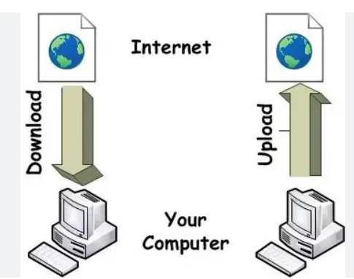
File upload & Download
File uploads and downloads in Playwright refer to the capability of interacting with file input elements to upload files
With Playwright, testers can automate file upload and download processes to ensure the reliability and functionality of web applications.

Slide 180
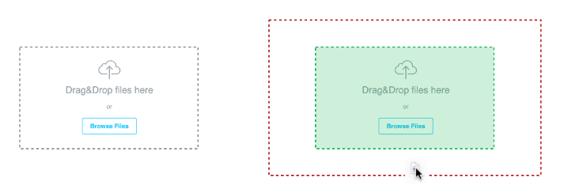
Drag-and-drop
Drag-and-drop Interaction: Drag-and-drop is a common user interaction pattern where users click and hold on an element, drag it to a different location, and then release the mouse button to drop it.
dragTo() Method: This method help s to achieve drag and Drop as below
await page.locator("#dragElement").dragTo(page.locator("#dropTarget"));

Slide 181
Drag & Drop code
test('Drag-and-drop Example', async ({ page }) => {
const sourceElement = await page.locator('#source');
const targetElement = await page.locator('#target’);
await page.locator("# source").dragTo(page.locator("# target"));
});
npx playwright test --project=chromium -g "@dragAndDrop" --headed

Slide 182
Keyboard and Mouse events

Slide 183
Keyboard & Mouse Events
Keyboard Events: Keyboard events are actions triggered by pressing or releasing keys on the keyboard. Examples include keydown, keyup, and keypress events.
Mouse Events: Mouse events are actions triggered by interactions with the mouse, such as clicking, hovering, dragging, and dropping.
Keyboard Input: Playwright provides methods to simulate keyboard input, allowing testers to send key presses, text input, and keyboard shortcuts programmatically.

Slide 184
Keyboard & mouse events
Mouse Interaction: clicking, double-clicking, right-clicking, hovering, dragging, and dropping.
Event Triggering: Test scripts can trigger keyboard and mouse events on specific elements or coordinates on the page
Event Handling: Web applications often respond to keyboard and mouse events by triggering actions or updating the UI.
Cross-Browser Compatibility: Playwright's keyboard and mouse event emulation works consistently across different browsers, ensuring consistent behavior across various browser environments.

Slide 185
Assertions & Testing

Slide 186
Assertions
Introduction to Assertions: Assertions are statements that verify whether expected outcomes match actual outcomes during testing. They are essential for validating the behavior of software components.
Integration with Testing Frameworks: Playwright seamlessly integrates with popular testing frameworks such as Jest, Mocha, and Jasmine, allowing developers to write expressive and robust test suites.

Slide 187
assertions
With Jest
expect(await page.title()).toBe('Example Domain’);
With Mocha
assert.equal(title, 'Example Domain');

Slide 188
assertions
Assertion | Description
expect(locator).toBeChecked() | Checkbox is checked
expect(locator).toBeEnabled() | Control is enabled
expect(locator).toBeVisible() | Element is visible
expect(locator).toContainText() | Element contains text
expect(locator).toHaveAttribute() | Element has attribute
expect(locator).toHaveCount() | List of elements has given length
expect(locator).toHaveText() | Element matches text
expect(locator).toHaveValue() | Input element has value
expect(page).toHaveTitle() | Page has title
expect(page).toHaveURL() | Page has URL

Slide 189
Choosing Library
Choosing an Assertion Library: While Jest and Mocha are popular choices, developers can also use other assertion libraries like Chai with Playwright to suit their preferences and project requirements.

Slide 190
Test Reporting

Slide 191
Test Reporting & CI
In built Reporting
HTML
JSON
LINE
Dot
LIST
Command =>
npx playwright test –reporter=json

Slide 192
Continuous integration
Continuous Integration (CI): Playwright's assertion integration ensures that tests accurately reflect the behavior of web applications across different environments.
Jenkins
Github actions
AWS cloud environments

Slide 193
Third-Party Reporting Libraries:
Allure: HTML reports with rich visualization of test execution results.
Mochawesome: HTML report with detailed test execution information.
Jest HTML Reporter: HTML report with detailed test results.
ReportPortal: ReportPortal is a customizable test reporting and analysis platform
ExtentReports: Generate interactive HTML reports with test execution details.

Slide 194
Writing assertions for various use cases

Slide 195
Verifying Page Title:
Use case: Ensure that the page title matches the expected title.
Assertion: expect(await page.title()).toBe('Expected Title');

Slide 196
Checking Element Visibility:
Use case: Confirm that a specific element is visible on the page.
Assertion: expect(await page.isVisible('.element-class')).toBeTruthy();

Slide 197
Validating Text Content:
Use case: Verify that the text content of an element matches the expected value.
Assertion: expect(await page.textContent('.element-class')).toContain('Expected Text');

Slide 198
Asserting Element Count:
Use case: Ensure that the page contains the expected number of elements matching a selector.
Assertion: expect(await page.$$('.element-class')).toHaveLength(3);

Slide 199
Checking Element State:
Use case: Verify that an element has a specific attribute or property set.
Assertion: expect(await page.evaluate('.element-class', el => el.getAttribute('attribute-name'))).toBe('expected-value');

Slide 200
Validating Element Properties:
Use case: Confirm that an element has specific properties or CSS styles applied.
Assertion: expect(await page.evaluate('.element-class', el => el.style.backgroundColor)).toBe('red');

Slide 201
Asserting Navigation:
Use case: Ensure that navigating to a specific URL results in the expected page content.
Assertion: expect(await page.url()).toBe('https://example.com');

Slide 202
Checking Network Requests:
Use case: Verify that certain network requests are made during page interactions.
Assertion: expect(await page.waitForRequest('https://api.example.com/data')).toBeTruthy();

Slide 203
Validating Form Submissions:
Use case: Confirm that form submissions result in the expected behavior or network requests.
Assertion: expect(await page.waitForResponse('https://api.example.com/submit')).toBeTruthy();

Slide 204
Structuring tests (describe, test blocks)

Slide 205
Describe Block
Structuring tests using describe and it blocks is a common practice in test frameworks like Jest or Mocha, and it can help organize and modularize your test suite.
describe('Login Page', () => {
// Test cases related to login functionality
});

Slide 206
test block
test('Should display an error message for invalid credentials', async () => {
// Test logic to verify error message display
});

Slide 207
Nested Describe Blocks
describe('User Profile', () => {
describe('Editing Profile', () => {
// Test cases related to editing user profile
});
describe('Viewing Profile', () => {
// Test cases related to viewing user profile
});
});

Slide 208
Before and After Hooks:
beforeEach(async () => {
/* Setup logic */
});
afterEach(async () => {
/* Teardown logic */
});

Slide 209
Describe & test blocks with Hooks
describe('User Authentication', () => {
beforeEach(async () => {
// Login before each test case
});
afterEach(async () => {
// Logout after each test case
});
test('Should allow access to authenticated users', async () => {
// Test logic for authenticated access
});
test('Should redirect unauthenticated users to login page', async () => {
// Test logic for unauthenticated access
});
});

Slide 210
Refresher

Slide 211
Refresher - Drag-and-drop:
Question: give me the function which helps in drag and drop
Answer: You can use the dragTo(target) method to simulate a drag-and-drop operation. Example: await page.locator("#dragElement").dragTo(page.locator("#dropTarget"));

Slide 212
Refresher - Keyboard and mouse events:
Question: How can you simulate keyboard events such as typing a text using Playwright?
Answer: You can use the page.fill(selector, text) method to simulate typing text into an element.
Example: await page.fill(<SOME_LOCATOR>), 'Hello, World!’).
Await page.locator(<SOME_LOCATOR>).fill(“This is the text”);

Slide 213
Refresher - Assertions and Testing:
Question: Which assertion libraries can you use with Playwright for writing tests?
Answer: You can use libraries like Jest, Mocha, or Chai for writing assertions in Playwright tests.
Question: How do you assert that an element is visible on the page using Playwright?
Answer: You can use the expect function along with Playwright's isVisible method to assert the visibility of an element.
Example: expect(await page.isVisible('.element')).toBeTruthy().

Slide 214
Refresher - Structuring tests (describe, it blocks):
Question: What is the purpose of the describe block in test scripts?
Answer: The describe block is used to group related test cases together.
Question: How can you execute setup and teardown logic before and after each test case in Playwright tests?
Answer: You can use the beforeEach and afterEach hooks to execute setup and teardown logic before and after each test case within the describe block.

Slide 215
Playwright Features

Slide 216
Handling Browser Dialogs:
Playwright provides methods like page.on('dialog') to intercept and handle browser dialogs such as alert, confirm, and prompt.
You can use the intercepted dialog object to accept, dismiss, or provide input to the dialogs.
npx playwright test --project=chromium -g "@dismiss" --headed
npx playwright test --project=chromium -g "@prompt" --headed
npx playwright test --project=chromium -g "@confirm" --headed

Slide 217
Intercepting New Windows or Tabs:
Use page.waitForEvent('popup') to intercept and handle new browser windows or tabs.
This allows you to perform actions on the new page, such as navigating or interacting with elements.
//npx playwright test --project=chromium -g "@openNewWindow" --headed

Slide 218
Dismissing Alert Dialogs:
To dismiss an alert dialog, use the dialog.dismiss() method.
This allows you to handle scenarios where an alert needs to be dismissed without user interaction.
npx playwright test --project=chromium -g "@dismiss" --headed

Slide 219
Working with Frames and Iframes

Slide 220
Navigating to Frames:
Use page.frame(name) or page.frame(url) to navigate to a frame by its name or URL.
You can also use page.frames() to get a list of all frames object on the page.
Iframes.spec.js

Slide 221
Interacting with Elements Inside Frames:
Once inside a frame, you can interact with elements using standard Playwright methods like click(), fill(), etc.
Ensure you switch to the correct frame context using page.frame() before interacting with elements inside it.

Slide 222
Navigating Between Frames:
Use page.waitForUrl() or other navigation methods to wait for frame navigations to complete.
When navigating between frames, ensure you switch to the appropriate frame context using page.frame().

Slide 223
Handling Nested Frames:
Playwright supports nested frames, allowing you to navigate through multiple levels of frames within frames.
Use page.waitForSelector() or other waiting methods to ensure elements inside nested frames are ready before interacting with them.
Ex.
Page.waitForSelector(<SomeSelector>);
Page.waitForSelector(“#StudentID”); //wait for StudentID id to load on the dom HTML

Slide 224
Identifying Frames:
Frames can be identified by their name, index, or URL.
Ensure you specify the correct identifier when switching to a frame using page.frame().

Slide 225
Frame Lifecycle Events:
Playwright emits events like 'frameattached' and 'framedetached' to notify when frames are attached or detached from the page.
You can listen for these events to handle dynamic changes to frame structures during test execution.
npx playwright test --project=chromium -g "@iframe" --headed

Slide 226
Network Interception and Mocking

Slide 227
Intercepting Network Requests:
Playwright provides the page.route(url, handlerFn) method to intercept network requests based on their URL.
You can define a custom handler function to intercept requests and modify their behavior as needed.
The handler function receives the intercepted request, allowing you to inspect and modify its properties, headers, and payload.

Slide 228
Mocking Responses:
With network interception, you can mock responses for intercepted requests to simulate various scenarios.
You can define custom response data

Slide 229
Dynamic Route Handling:
Playwright supports dynamic route handling, allowing you to modify the response based on the intercepted request's properties.
await context.route('**/api/data', route => {
route.fulfill({
status: 200,
contentType: 'application/json',
body: JSON.stringify({ message: 'Mocked data response' })
});
});
You can conditionally respond to requests based on their method, URL, headers, or other criteria defined in the handler function.

Slide 230
Examples of Use Cases:
Mocking API responses to test client-side behavior without relying on actual backend services.
Testing different scenarios such as successful responses, timeouts, or error conditions to ensure robustness.
npx playwright test --project=chromium -g "@mock" --headed

Slide 231
Defining the Route Handler:
The route handler function receives the intercepted request object as its parameter.
Inside the handler function, you can inspect and modify properties of the intercepted request.
await page.route('**/*.png', route => {
console.log('Intercepted request:', route.request().url());
// Modify request headers, respond with custom data, or abort the request
});

Slide 232
Mocking responses

Slide 233
Defining the Route Handler:
Inside the route handler function, you construct a mocked response using Playwright's route.fulfill() method.
You can specify response status code, headers, and body content to be sent back to the application.

Slide 234
Code – Mock resposne
await page.route('**/api/data', route => {
const responseBody = { message: 'Mocked response data' };
route.fulfill({
status: 200,
contentType: 'application/json',
body: JSON.stringify(responseBody)
});
});

Slide 235
Refresher

Slide 236
Refresher - Handling Pop-ups and Dialogs:
Question: How can you handle browser pop-ups and dialogs opens in Playwright?
Answer: You can handle pop-ups and dialogs using Playwright's page.on('dialog') event handler.

Slide 237
Refresher - Working with Frames and Iframes:
Question: How can you interact with Iframes in Playwright?
Answer: iframes are independent HTML documents embedded within another HTML document. In Playwright, you can interact with iframes using the page.frames() method to access frame elements and perform actions within them.
frame = page.frame(name="frame-name")
frame = page.frame(url=r".*domain.*")
locator = page.frame_locator("#my-iframe").get_by_text("Submit") await locator.click()

Slide 238
Refresher - Network Interception and Mocking:
Question: What is network interception and mocking, and how can you use it in Playwright?
Answer: Network interception in Playwright allows you to intercept and modify network requests and responses during test execution. Mocking responses involves simulating server responses for intercepted requests, allowing you to control the behavior of network communication in your tests.

Slide 239
Refresher - Intercepting Network Requests:
Question: which method help you intercept network requests in Playwright?
Answer: You can intercept network requests in Playwright using the page.route() method

Slide 240
refresher
Question: Which route method helps you to mock response received from server?
Answer : Route.fulfil()

Slide 241
Managing States and Testing Strategies

Slide 242
Handling Authentication
Playwright supports automating authentication processes such as logging in with credentials, handling login forms, and managing authentication tokens.
You can use Playwright's page.fill() method to input credentials into login forms and submit them programmatically.
Playwright also provides options for handling various authentication mechanisms such as basic authentication, OAuth, and JWT tokens.
npx playwright test --project=chromium -g "@login" –headed
npx playwright test --project=chromium -g "@storageStateLogin"

Slide 243
State Management:
State management in Playwright involves maintaining and managing the state of the application under test, including cookies, local storage, and session data.
Playwright allows you to manipulate cookies using methods like page.setCookies() and page.clearCookies() to manage authentication states and user sessions.
You can also interact with the browser's local storage and session storage using Playwright's page.evaluate() method to read, write, and clear stored data.

Slide 244
Clearing State Between Tests:
It's essential to clear any persisted state between tests to ensure test independence and avoid interference from previous test executions.
Playwright offers methods to reset browser contexts, clear cookies, and delete stored data programmatically before starting each test.

Slide 245
Using context storage for state reuse

Slide 246
Context Storage Overview:
Playwright allows storing and sharing data across browser contexts using context storage.
Context storage provides a mechanism for persisting data between test runs within the same browser context.

Slide 247
Storing State Data:
You can use context storage to store various types of data, including authentication tokens, user preferences, or application settings.
Playwright provides methods like context.storageState() to capture the current state of the context and context.setStorageState() to set stored state data.

Slide 248
Reusing State Data Across Tests:
By storing state data in context storage, you can reuse it across multiple tests within the same browser context.
Reusing state data eliminates the need to repeat setup steps or login actions in each test, improving test efficiency and reducing execution time.

Slide 249
Maintaining Test Independence:
It's essential to ensure that tests remain independent and isolated, even when reusing state data from context storage.
Playwright allows creating new browser contexts for each test or clearing existing context storage to maintain test independence and prevent interference between tests.

Slide 250
Sharing State Across Scenarios:
Context storage enables sharing state data not only within individual tests but also across different test scenarios or test suites.
By storing commonly used data centrally in context storage, you can ensure consistency and streamline test execution across various scenarios.

Slide 251
refresher

Slide 252
refresher - Authentication and State Management:
Question: What are the primary challenges associated with authentication and state management in automated testing?
Answer: The primary challenges include handling login sessions, maintaining user authentication state across tests, and ensuring secure storage and retrieval of sensitive credentials.

Slide 253
refresher - Using Context Storage for State Reuse:
Question: How does context storage facilitate state reuse in Playwright tests?
Answer: Context storage allows storing and retrieving application state, such as user authentication tokens or session data, across test runs. This enables tests to maintain a consistent state, reducing setup overhead and enhancing test efficiency and reliability.

Slide 254
Automation Good Practices

Slide 255
Code modularity
Definition:
Code modularity is a software design approach where code is organized into independent and reusable modules.
Benefits:
Promotes code reuse and maintainability.
Enhances readability and scalability of the codebase.
Simplifies debugging and troubleshooting.

Slide 256
Implementation in Playwright:
Encapsulate common functionalities into reusable functions or helper classes.
Organize test scripts into logical modules based on functionality or feature sets.

Slide 257
Page Objects:
Definition: Page Objects is a design pattern used in test automation where web pages are represented as objects in code, encapsulating their structure and behavior.

Slide 258
Purpose:
Provides a clean and maintainable way to interact with web pages.
Reduces code duplication and enhances test readability.
Improves test maintainability by centralizing page-specific logic.

Slide 259
Implementation in Playwright:
Define separate classes or modules to represent each web page or component.
Encapsulate page-specific elements and actions within the respective Page Object classes.
Use Page Objects in test scripts to interact with web elements and perform actions on pages.

Slide 260
Page Object Model

Slide 261
POM
Definition: Page Object Model (POM) is a design pattern used in test automation to create an abstraction layer that represents web pages as objects in code.
npx playwright test -g "@pom" --project=chromium –headed //withoutMainClass
npx playwright test -g "@subtraction" --headed --workers=2 //withMainClass
npx playwright test -g "@mainPom" --headed --workers=2 //withMainClass

Slide 262
POM class Example
// Methods
async login(username, password) {
await this.usernameInput.type(username);
await this.passwordInput.type(password);
await this.loginButton.click();
}
async isLoggedIn() {
return await this.page.locator('#logoutButton').isHidden();
// Assuming logout button is visible only when logged in
}
}
module.exports = LoginPage;
class LoginPage {
constructor(page) {
this.page = page;
}
// Element locators
getUsernameInput() {
return this.page.locator('#username’);
}
getPasswordInput() {
return this.page.locator('#password’);
}
getLoginButton() { return this.page.locator('#loginButton'); }

Slide 263
Purpose – Page object
Enhances test maintainability and readability by separating page-specific logic from test scripts.
Promotes code reusability and reduces duplication by encapsulating page elements and actions into reusable components.
Facilitates easier maintenance and updates as changes to page structure or functionality can be managed within the Page Objects.

Slide 264
Components
Page Objects: Classes or modules that represent individual web pages or components.
Page Elements: Web elements such as buttons, input fields, and links defined within Page Objects.
Page Actions: Methods or functions that perform interactions with page elements, like clicking buttons, entering text, or navigating.

Slide 265
Implementation
Define separate Page Object classes for each web page or component.
Encapsulate page elements and actions within their respective Page Object classes.
Utilize Page Objects in test scripts to interact with web elements and perform actions on pages, promoting code modularity and reusability.

Slide 266
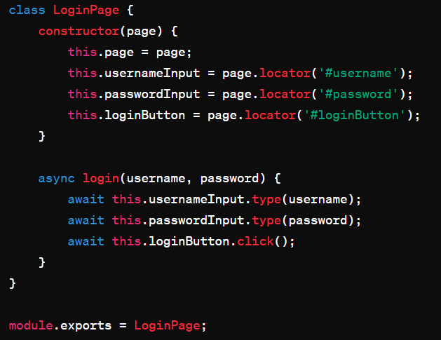
POM Login Class

Slide 267
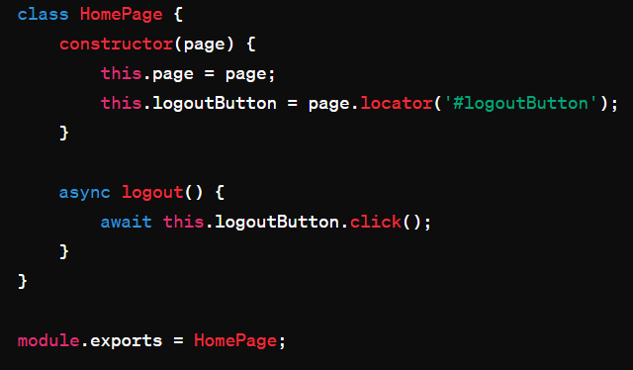
Pom Home Page class

Slide 268
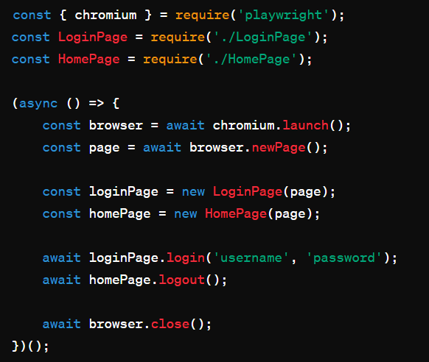
Actual Pom usage

Slide 269
POM Pages in one view

Slide 270
refresher

Slide 271
refresher - Code Modularity and Page Objects:
Question: What is the primary goal of using page objects in test automation?
Answer: The primary goal of using page objects is to achieve code modularity and maintainability by encapsulating page-specific functionality and locators within reusable components.

Slide 272
refresher - Page Object Model (POM) Introduction:
Question: What is the Page Object Model (POM) in test automation?
Answer: The Page Object Model (POM) is a design pattern in test automation that promotes the creation of reusable page objects to represent web pages or components.
It helps improve test maintainability, readability, and reusability by separating page-specific logic from test scripts.

Slide 273
Dealing with flaky tests

Slide 274
What is Flaky tests
Flaky tests are automated tests that produce non-deterministic results, meaning they may pass or fail inconsistently when run under the same conditions.
These tests are unreliable because their outcome is unpredictable, making it challenging to determine whether the software under test is functioning correctly.

Slide 275
Reasons of flakiness
Timing issues: Flaky tests may depend on factors such as network latency, system load, or asynchronous operations. Variations in timing can cause the test to pass or fail inconsistently.
Test environment: Differences in the test environment, such as hardware configurations, operating systems, or software dependencies, can lead to variations in test results.
Intermittent failures: Some issues within the software being tested may be intermittent, causing the test to fail sporadically.

Slide 276
Reasons of flakiness
Test data: Flaky tests may be sensitive to changes in test data or the state of the application. If the test data or application state is not properly managed, the test results may vary.
Race conditions: Tests that involve concurrent or parallel execution may encounter race conditions, where the outcome depends on the relative timing of multiple threads or processes.
Resource contention: Tests that compete for shared resources, such as database connections or file system access, may encounter contention issues that lead to inconsistent results.

Slide 277
Identification of Flaky tests
Monitor test execution for inconsistency or unpredictability in results.
Analyze test logs, screenshots, and error messages to identify patterns of failure.
Use test reporting tools to track test stability and identify flaky tests.

Slide 278
Root Cause Analysis:
Investigate potential causes of flakiness, such as network issues, race conditions, or environmental factors.
Review test code and dependencies for potential sources of instability.
Consider timing-related issues, asynchronous operations, or external dependencies.

Slide 279
Mitigation Strategies:
Implement explicit waits and synchronization mechanisms to ensure test stability.
Retry flaky tests with back off strategies to reduce the impact of transient failures.
Use test isolation techniques, such as running tests in clean environments or sandboxed contexts.

Slide 280
Collaboration:
Foster collaboration between developers, testers, and stakeholders to address flakiness.
Share knowledge and best practices for writing stable and resilient tests.
Encourage a culture of continuous improvement and collective ownership of test reliability.

Slide 281
refresher

Slide 282
refresher - Dealing with Flaky Tests:
Question: How can you mitigate flaky tests in test automation?
Answer: Flaky tests can be mitigated by implementing strategies such as explicit waits, synchronization mechanisms, retry mechanisms with backoff strategies, test isolation techniques, regular code reviews and refactoring, and fostering collaboration between team members for identifying and addressing root causes of flakiness.

Slide 283
Accessibility Testing

Slide 284
Introduction to Accessibility Testing:
Accessibility testing ensures that web applications are usable by people with disabilities, such as those with visual, auditory, motor, or cognitive impairments.
It aims to ensure that all users, regardless of their abilities, can access and interact with web content effectively.

Slide 285
Common Accessibility Issues

Slide 286
Common Accessibility Issues:
Missing or incorrect alternative text for images.
Lack of keyboard navigation support.
Insufficient color contrast for text and background elements.
Inaccessible form fields without proper labels or instructions.
Improper use of headings, landmarks, and ARIA (Accessible Rich Internet Applications) attributes.
Non-semantic HTML markup that affects screen reader compatibility.

Slide 287
Benefits of Accessibility Testing

Slide 288
Benefits of Accessibility Testing:
Improves usability for all users, including those with disabilities.
Enhances compliance with accessibility standards and regulations.
Helps organizations reach a broader audience and improve user satisfaction.
Reduces legal risks associated with accessibility non-compliance.

Slide 289
Approaches to Accessibility Testing

Slide 290

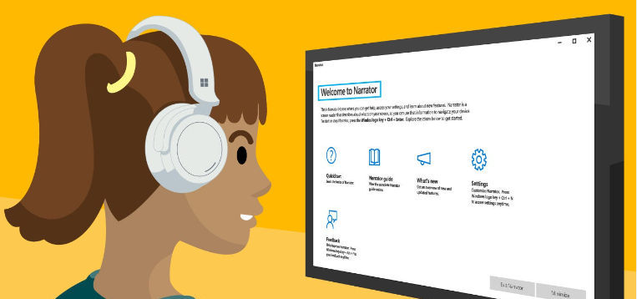
Approaches to Accessibility Testing:
Manual Testing: Involves human testers reviewing web content for accessibility issues, using assistive technologies such as screen readers and keyboard navigation.
Screen readers are assistive technology software applications that provide auditory feedback to users who are blind or visually impaired.

Slide 291
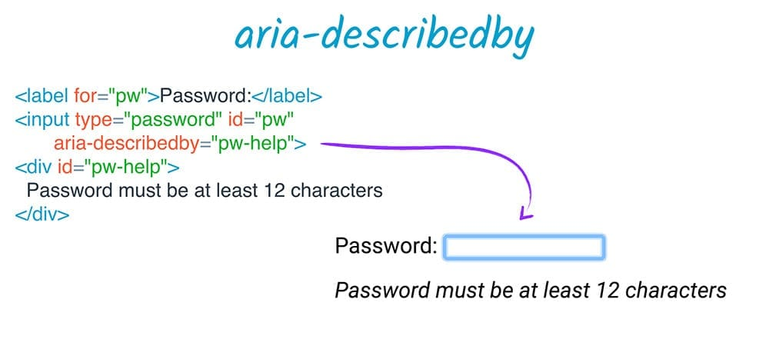
Automated Testing
Automated Testing: Utilizes tools like Playwright to automate accessibility checks, including keyboard navigation, ARIA attributes, color contrast, and semantic markup.

Slide 292
Best Practices for Accessibility Testing

Slide 293
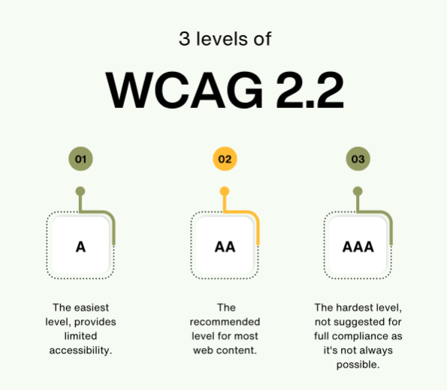
Levels

Slide 294
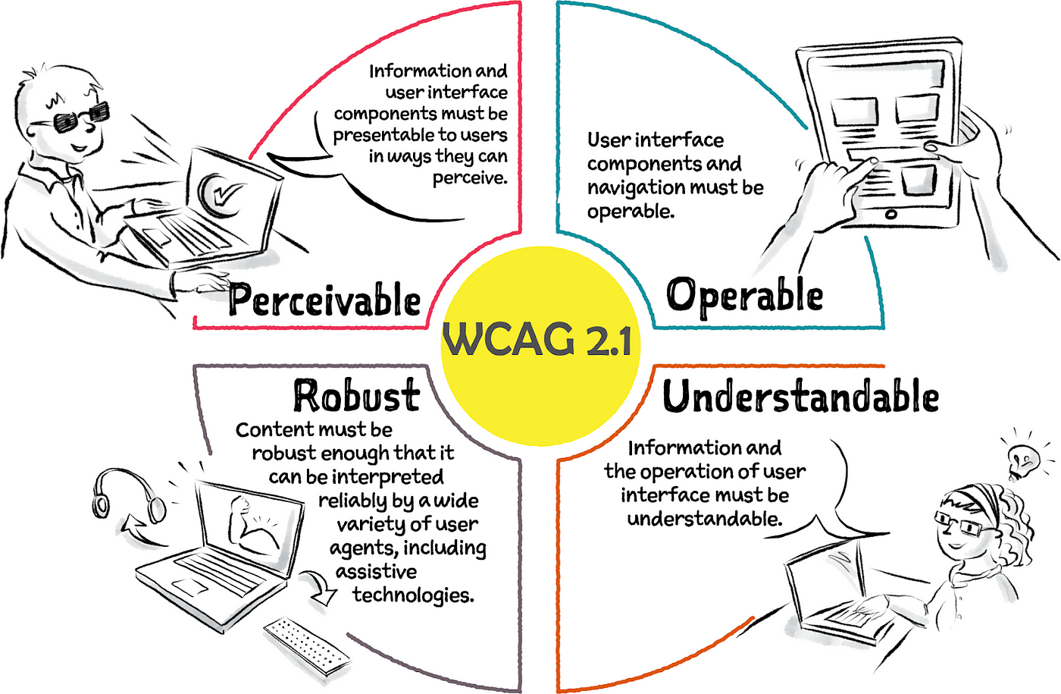
Guidelines

Slide 295
Best Practices for Accessibility Testing:
Familiarize yourself with accessibility standards, such as WCAG (Web Content Accessibility Guidelines).
Incorporate accessibility testing into the development lifecycle, from design to deployment.
Involve users with disabilities in testing to gather real-world feedback.
Use a combination of automated and manual testing approaches to ensure comprehensive coverage.
Continuously monitor and address accessibility issues throughout the development process.

Slide 296
Tools for Accessibility Testing

Slide 297
Tools for Accessibility Testing:
Playwright: Provides APIs for automating accessibility checks and interacting with web elements programmatically.
Axe-core: A JavaScript library for automated accessibility testing, integrated with Playwright and other testing frameworks.
Lighthouse: An open-source tool from Google for auditing web page performance, accessibility, and best practices.

Slide 298
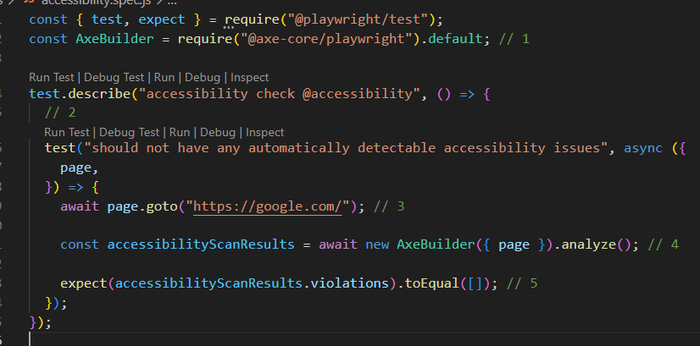
Code

Slide 299
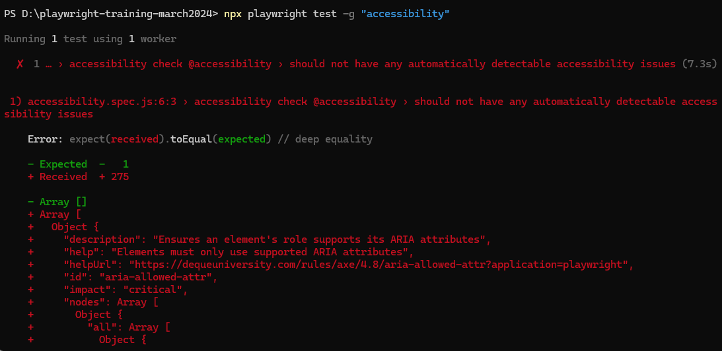
Reporting on command line

Slide 300
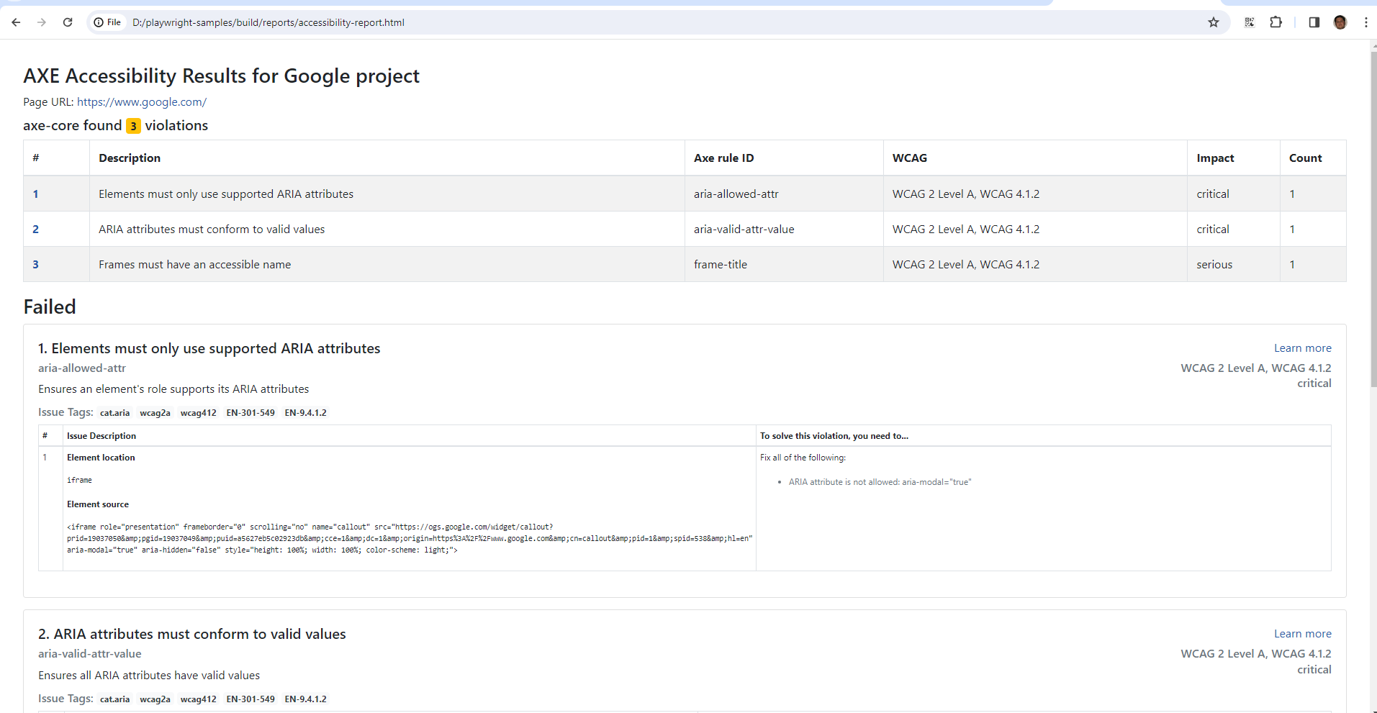

Slide 301
Strict Countries for Accessibility

Slide 302
Strict Countries for Accessibility
United States
European Union
Canada
Australia
United Kingdom
Japan

Slide 303
Accessibility compliance

Slide 304
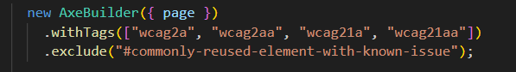
Metrics and Reporting:
Measure accessibility compliance using metrics such as WCAG conformance levels (A, AA, AAA).
Generate accessibility reports with detailed findings, recommendations, and remediation steps for developers.

Slide 305
Visual Regression Testing

Slide 306
Introduction to Visual Regression Testing:
Visual regression testing is a technique used to detect unintended visual changes in web applications between different versions or environments.
It involves capturing screenshots of web pages and comparing them pixel by pixel to identify visual discrepancies.

Slide 307
Common Use Cases:
Detecting layout shifts or styling changes caused by code updates.
Ensuring consistent rendering across browsers, devices, and screen sizes.
Validating changes to UI components, such as buttons, forms, and navigation menus.
Monitoring third-party integrations and dependencies for visual changes.

Slide 308

How Visual Regression Testing Works:
Capture Baseline Screenshots:
Capture Test Screenshots:
Perform Image Comparison:
Identify Differences:
Review and Analyze:

Slide 309
Benefits of Visual Regression Testing:
Helps prevent visual bugs and regressions from reaching production.
Improves UI consistency and user experience by detecting subtle design changes.
Increases confidence in code changes and deployments by validating visual integrity.
Facilitates collaboration between developers, designers, and QA teams by providing visual feedback.

Slide 310
Approaches to Visual Regression Testing:
Automated Testing: Use tools like Playwright with visual regression testing libraries (e.g., Percy, Applitools) to automate screenshot capture and comparison.
Manual Review: Perform manual visual inspections of screenshots to identify discrepancies, especially for complex or dynamic UI elements.
Integration with CI/CD Pipelines: Integrate visual regression tests into your CI/CD pipelines to detect visual changes early in the development process.

Slide 311
Best Practices for Visual Regression Testing:
Establish a Baseline: Create a baseline of screenshots for stable and consistent UI elements.
Define Tolerances: Set tolerance levels for image comparison to account for minor visual differences and avoid false positives.
Maintain Test Coverage: Regularly update and expand visual regression test suites to cover critical UI components and user workflows.
Review and Triaging: Review visual diffs regularly, triage findings, and address legitimate regressions promptly.
Collaboration and Communication: Foster collaboration between development, design, and QA teams to resolve visual discrepancies efficiently.

Slide 312
Tools for Visual Regression Testing:
Playwright: Provides APIs for capturing screenshots and automating visual regression tests across different browsers and devices.
Percy: A visual testing platform that integrates with Playwright to capture and compare screenshots for visual regression testing.
Applitools: A visual AI platform for automated visual testing, offering advanced features like layout testing and cross-browser testing.

Slide 313
Continuous Integration

Slide 314
Continuous Integration (CI) with Playwright:
Playwright seamlessly integrates with popular CI/CD platforms like Jenkins, Travis CI, CircleCI, and GitHub Actions.
CI pipelines can be configured to automatically trigger Playwright tests whenever changes are pushed to the repository, ensuring that new code is thoroughly tested before deployment.
Playwright's ability to run tests across multiple browsers and environments makes it well-suited for CI workflows, allowing developers to catch cross-browser compatibility issues early in the development cycle.

Slide 315
Key Benefits of Reporting and CI in Playwright:
Visibility: Test reports provide stakeholders with visibility into the overall health of the application and the quality of recent code changes.
Accountability: Detailed test reports hold developers accountable for the quality of their code, encouraging them to write robust tests and address failures promptly.
Rapid Feedback: CI pipelines provide rapid feedback on code changes, allowing developers to identify and fix issues before they escalate.
Automation: Automated testing and reporting streamline the development process, reducing manual effort and enabling faster delivery of high-quality software.

Slide 316
Best Practices for Reporting and CI:
Comprehensive Test Coverage: Ensure that tests cover critical functionality and edge cases to maximize the effectiveness of reporting and CI.
Fast Feedback Loops: Optimize CI pipelines for speed to provide developers with timely feedback on their changes.
Integration with Issue Tracking: Integrate test reports with issue tracking systems like Jira or GitHub Issues to facilitate issue triaging and resolution.
Version Control: Store test reports alongside code changes in version control systems for traceability and historical analysis.
Scheduled Runs: Schedule regular test runs as part of the CI process to continuously monitor application health and detect regressions.

Slide 317
refresher

Slide 318
refresher - Visual Regression Testing:
Question: What is visual regression testing, and why is it important in web development?
Answer: Visual regression testing involves comparing screenshots of an application's UI before and after changes to detect unintended visual regressions.
It ensures that UI components remain consistent across different versions of an application, preventing layout shifts, styling errors, and other visual inconsistencies.

Slide 319
refresher -Reporting and Continuous Integration:
Question: What role do reporting and continuous integration (CI) play in the software development process?
Answer: Reporting provides insights into test results, helping teams identify issues and track progress.
Continuous integration (CI) automates the process of building, testing, and deploying code changes, ensuring that applications remain stable and reliable.
Together, reporting and CI enable teams to maintain high-quality software and accelerate development cycles.

Slide 320
refresher - Generating test reports:
Question: Why is generating test reports important, and how can it be done in Playwright?
Answer: Test reports provide visibility into test results, helping teams identify failures, track progress, and make informed decisions.
In Playwright, test reports can be generated using built-in reporting tools or integrated with third-party services.
Reports typically include information such as test outcomes, execution times, and error details, enabling teams to improve application quality and development processes.

Slide 321
refresher - Setting up Playwright with CI/CD (e.g., GitHub Actions):
Question: What are the benefits of setting up Playwright with CI/CD, and how can it be achieved using platforms like GitHub Actions?
Answer: Setting up Playwright with CI/CD enables teams to automate testing and deployment processes, ensuring consistent and reliable application delivery.
With platforms like GitHub Actions, Playwright tests can be integrated into CI/CD pipelines, allowing for automatic execution of tests on code changes and providing immediate feedback to developers.
This improves development efficiency, reduces time-to-market, and enhances overall software quality.

Slide 322
REFRESHER
Question :- what should be the extension of a workflow file?
Answer : yaml or yml
Question: - In which folder do we need to create our workflow file ?
Answer => .github => workflows => <SOMEFILE>

Slide 323
Advanced Topics and Custom Tools

Slide 324
Custom browser contexts
Custom browser contexts in Playwright allow developers to create isolated browsing environments with specific configurations.
Each browser context can have its own set of cookies, storage, permissions, and other settings, providing flexibility in testing scenarios.
Custom browser contexts are useful for simulating different user sessions, testing authentication flows, and isolating test cases.
They can be created using the browser.newContext() method and configured with options such as viewport size, geolocation, and user agent.
Browser contexts can be shared across multiple test cases or disposed of after use to ensure clean test environments.

Slide 325
Devices:
Playwright provides built-in device emulation to simulate various devices and viewports, such as smartphones, tablets, and desktops.
Device emulation allows developers to test how web applications render and behave on different screen sizes and resolutions.
Playwright offers a predefined list of devices with specific viewport dimensions and user agents, including popular devices like iPhone, iPad, and Google Pixel.
Device emulation can be enabled by passing device options to the browser.newContext() method or using the browserContext.emulateDevice() method.
Testing on different devices helps ensure that web applications are responsive and provide a consistent user experience across various platforms and form factors.

Slide 326
Emulating Devices
Built-in Device Emulation:
Viewport and User Agent:
Device Options: Device name or model, viewport size, screen orientation (landscape or portrait), and other device-specific properties.
Viewport and User Agent Override: can override the default viewport size and user agent string to customize the testing environment further.
Viewport Size and Pixel Ratio: device's pixel density (pixel ratio) to accurately render web content. Developers can adjust the pixel ratio

Slide 327
Browser Launch Options:
headless (boolean): Whether to run the browser in headless mode (true for headless, false for headed).
slowMo (number): Slows down Playwright operations by the specified amount of milliseconds. This is useful for debugging and observing the test execution.
args (string[]): Additional command-line arguments to pass to the browser instance.
executablePath (string): Path to the browser executable to use instead of the bundled one.

Slide 328
Launch options
ignoreHTTPSErrors (boolean): Whether to ignore HTTPS errors during navigation.
viewport (ViewportSize): Specifies the initial browser viewport size.
defaultViewport (ViewportSize): Specifies the default viewport size when the browser window is first opened.
userDataDir (string): Path to a user data directory to use for the browser instance.
channel (string): Channel to use for the browser instance (e.g., "chrome", "firefox", "webkit").

Slide 329
Context Options:
User agent
Device emulation
Permissions ex. geolocation
Storage state – sessionStorage, localStorage, cookies etc

Slide 330
permissions
geolocation: Grants or denies access to the Geolocation API.
notifications: Grants or denies the ability to display notifications.
push: Grants or denies the ability to display push notifications.

Slide 331
permissions
camera: Grants or denies access to the camera.
microphone: Grants or denies access to the microphone.
backgroundSync: Grants or denies access to background sync functionality.
ambientLightSensor: Grants or denies access to the ambient light sensor.

Slide 332
permissions
accelerometer: Grants or denies access to the accelerometer.
gyroscope: Grants or denies access to the gyroscope.
magnetometer: Grants or denies access to the magnetometer.
clipboardReadWrite: Grants or denies access to read and write from the clipboard.

Slide 333
Permissions – playwright config
use: {
permissions: {
geolocation: 'granted',
notifications: 'denied',
camera: 'prompt',
microphone: 'prompt',
},

Slide 334
refresher

Slide 335
refresher - Custom Browser Contexts and Devices:
Question: How can you customize browser contexts and devices in Playwright?
Answer: You can define custom browser contexts with specific configurations such as permissions, cookies, and storage isolation.
Additionally, Playwright allows you to emulate various devices like smartphones, tablets, or custom screen sizes for responsive testing.

Slide 336
refresher - Emulating Devices:
Question: What does emulating devices in Playwright allow?
Answer: Emulating devices in Playwright allows you to simulate the behavior of various devices like smartphones, tablets, or IPADS etc.
This enables you to test how your web application renders and behaves across different screen sizes and device capabilities.

Slide 337
refresher - Custom Browser Options:
Question: How can you customize browser options in Playwright?
Answer: Playwright provides the flexibility to customize browser options such as launch settings, viewport size, user agent, and browser preferences.
These options allow you to tailor the browser environment to match specific testing scenarios and requirements.

Slide 338
DEbugging

Slide 339
Various ways of debugging

Slide 340
Various ways of debugging
Console Output: You can use console.log() statements in your Playwright scripts to output variable values, messages, or any other information to the console. This can help you track the flow of your script and identify any issues.
Error Handling: Implement error handling in your Playwright scripts using try-catch blocks. This allows you to catch and handle errors gracefully, providing useful error messages or performing specific actions when errors occur.
Debugging Statements: Use debugging statements like debugger in your code. When the script encounters a debugger statement, it will pause execution, allowing you to inspect variables, step through code, and analyze the state of the application at that point.
Visual Studio Code Debugger: If you're using Visual Studio Code as your code editor, you can debug Playwright scripts directly within the editor. You can set breakpoints, inspect variables, step through code, and use other debugging features provided by Visual Studio Code.

Slide 341
Various ways of debugging
Headful Mode: Run your Playwright scripts in headful mode ({ headless: false }). This allows you to see the browser window and interact with it during script execution, making it easier to visually inspect the state of the application.
Logging interception : Enable logging in Playwright to capture detailed information about the actions performed by the browser during script execution. You can log / intercept various events such as page navigations, network requests, and console messages, which can help you diagnose issues.
Page Screenshots: Take screenshots of the page at different stages of script execution. This can help you visually inspect the state of the page and identify any unexpected behavior or layout issues.
Inspect Browser DevTools: Use the built-in browser DevTools to inspect the DOM, view console messages, debug JavaScript code, and analyze network activity. Playwright provides methods to launch and interact with the browser DevTools programmatically from your scripts.

Slide 342
Debugging using command Line

Slide 343
Debugging in Windows Powershell
You can use –debug (dash dash debug) parameter to debug the playwright test case, it opens the inspector window
npx playwright test --grep --% "@submit" --headed --project=chromium - - debug

Slide 344
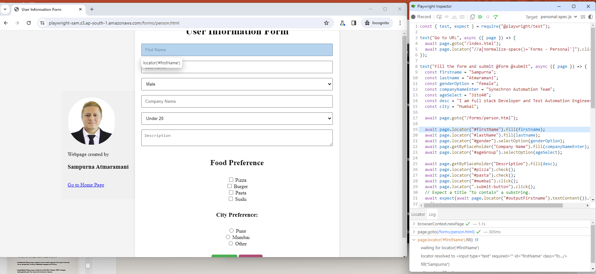
Inspect window

Slide 345
Debugging using Environment variables

Slide 346
Various debug options
pw:browser: Debug output related to the browser instances managed by Playwright, including browser launch, page navigation, and page closing events.
pw:channel: Debug output related to communication between Playwright's client and server components, including WebSocket messages and RPC calls.
pw:protocol: Debug output related to the DevTools Protocol (CDP) messages exchanged between Playwright and the browser instances.

Slide 347
Various debug options
pw:rpc: Debug output related to Remote Procedure Calls (RPC) between Playwright's client and server components.
pw:api: Debug output related to Playwright's JavaScript API, including method calls and their parameters.
pw:verbose: Enables verbose debug output, providing more detailed information compared to other debug options.
pw:network: Debugging with pw:network is like becoming a detective in the world of web requests and responses.

Slide 348
Debugging hands on

Slide 349
Debugging
You can also set the environment variable
$env:PWDEBUG=1
Step 2 Execute any command
npx playwright test --grep --% "@addition" --headed --project=chromium
It will halt the execution on browser debugger

Slide 350
Environment variables
//Start Debugging in powershell
$env:DEBUG="pw:browser"
$env:DEBUG="pw:channel"
$env:DEBUG="pw:protocol"
$env:DEBUG="pw:api"
$env:DEBUG="pw:network"

Slide 351
Remove Debugging in power shell
//Remove Debugging in power shell
Remove-Item Env:\DEBUG

Slide 352
Remove Debugging Environment var in power shell

Slide 353
Passing Debug option
npx playwright test –debug

Slide 354
Debug using trace

Slide 355
Code Generator
Npx playwright CODEGEN

Slide 356
Code Generator Command
Syntax
Option 1 => npx playwright codegen [HIT ENTER and then enter the url on browser]
Option 2 => npx playwright codegen <URL>
Ex.
npx playwright codegen demo.playwright.dev/todomvc
npx playwright codegen google.com

Slide 357
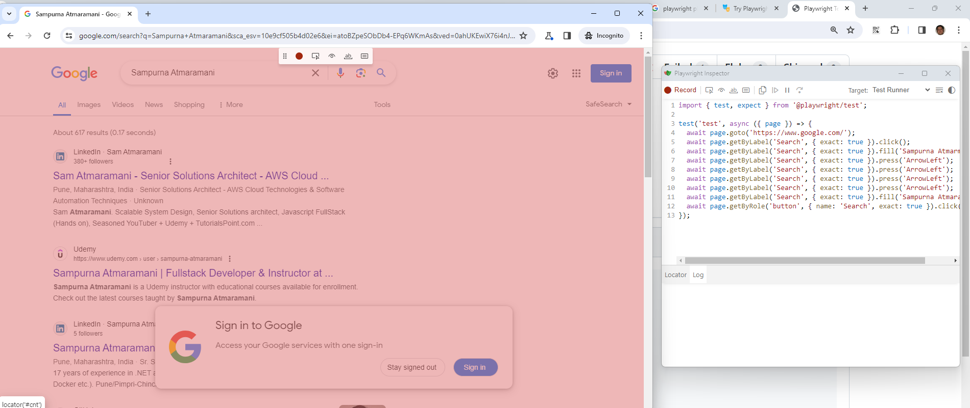
CodeGen auto generated program

Slide 358
Trace

Slide 359
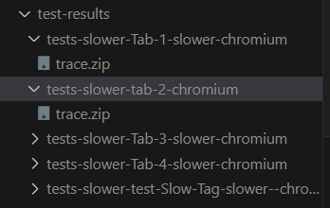
trace
Command to trace
1. npx playwright test --trace on
2. npx playwright test --grep --% "@slower" --headed --project=chromium --workers=1 --trace on
Example command to check trace logs
npx playwright show-trace test-results\tests-slower-Tab-1-slower-chromium\trace.zip

Slide 360
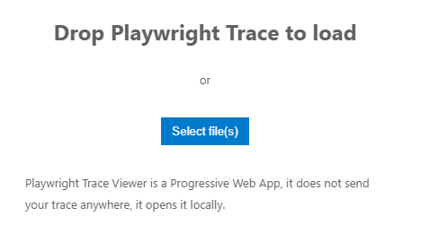
Trace online
You can alternatively go to https://trace.playwright.dev/
Upload the trace file and view the tracing

Slide 361
Run tests in VS Code

Slide 362
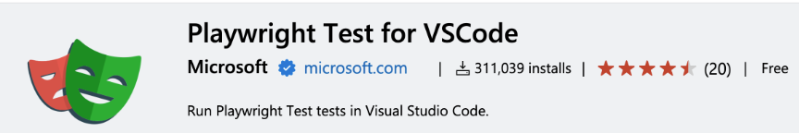
Run tests in VS Code
Install below extension in VS code

Slide 363
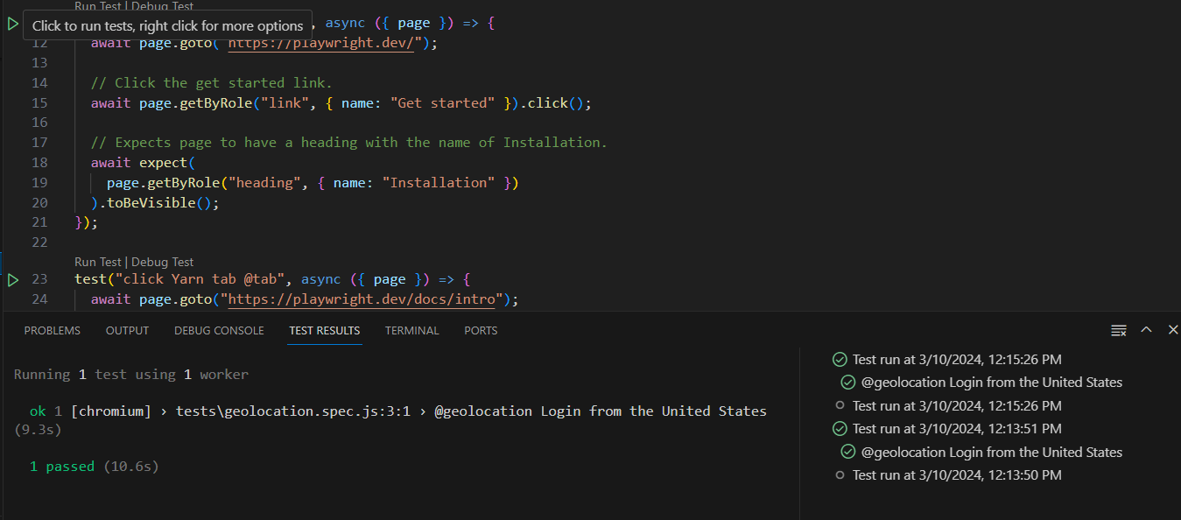
Run test IN VS code

Slide 364
Browser Context options

Slide 365
Context options
recordVideo (RecordVideoOptions): Records a video of the browser's execution.
npx playwright test --project=chromium --trace on -g "@recordvideo" --headed --workers=2
recordHar (RecordHarOptions): Records a HAR (HTTP Archive) file of network traffic.
viewport (ViewportSize): Specifies the initial browser viewport size.
userAgent (string): Specifies the user agent string to use for the browser context.
locale (string): Specifies the locale to use for the browser context.

Slide 366
Context Option
timezoneId (string): Specifies the timezone to use for the browser context.
permissions (string[]): Specifies the list of permissions to grant for the browser context.
geolocation (GeolocationOptions): Specifies the geolocation coordinates to use for the browser context.
httpCredentials (HTTPCredentials): Specifies HTTP credentials to use for the browser context.
deviceScaleFactor (number): Specifies the device scale factor to use for the browser context.
isMobile (boolean): Specifies whether the browser context should emulate a mobile device.

Slide 367
devices

Slide 368
Devices
Desktop:
Desktop Chrome
Desktop Firefox
Desktop Safari
Desktop Edge
Mobile:

Slide 369
phones

Slide 370
Phones
iPhone 12
Pixel 5
Galaxy S20
iPad Mini
Nexus 7
iPhone SE

Slide 371
tablets

Slide 372
Tablets:
iPad
iPad Pro
iPad Mini

Slide 373
Grep commands

Slide 374
Grep commands
Basic Usage: You can use --grep followed by a string to match against the descriptions or names of tests.
npx playwright test --grep "Addition"
npx playwright test --grep "calculations.spec.js"

Slide 375
Grep commands
Regular Expressions: You can use regular expressions to match test descriptions or names.
Example: --grep "/login|signup/"
Case Insensitive Match: Use the i flag after the regular expression to perform a case-insensitive match.
Example: --grep "/login|signup/i"

Slide 376
Grep commands
Negation: Use ! to negate the match, meaning tests that don't match the pattern will be executed.
Example: --grep "!login"
Matching Test Files: You can also use --grep to match test filenames.
Example: --grep "login.spec"

Slide 377
Grep commands
Matching Entire Test Path: Match the entire test file path.
Example: "/path/to/test/login.spec“
npx playwright test tests/calculations.spec.js --project=chromium
Matching Entire Test Path and Test Name: Match both the test file path and the test name.
Example: --grep "/path/to/test/login.spec::testLogin"

Slide 378
Grep commands
Excluding Specific Tests: Use ! to exclude specific tests from being executed.
Example: --grep "!login" --grep "signup"
Combining Multiple Patterns: You can combine multiple --grep options to filter tests based on multiple patterns.
Example: --grep "login" --grep "signup"

Slide 379
Example commands
npx playwright test --grep --% "@geolocation" --project=chromium --headed
//to run only two type of tagged tests
npx playwright test --grep --% "@fast^|@tab2"
//it should open browser using --headed option
npx playwright test --grep --% "@fast^|@tab2" --headed

Slide 380
commands
//it should only run on chrome browser
npx playwright test --grep --% "@fast^|@tab2" --headed --project=chromium
//run multiple tests based on one common tag
npx playwright test --grep --% "@calculations" --headed --project=chromium
npx playwright test --grep --% "@fast^|@tab2" --headed --project=smoke
npx playwright test --grep --% "@fast^|@tab2" --headed --project=prod

Slide 381
commands
//run for two projects
npx playwright test test --grep --% "@fast^|@tab2" --headed --project=MobileSafari --project=MobileChromeViewPort
//run on multi devices settings
npx playwright test test --grep --% "@fast^|@tab2" --headed --project=mutipleDevices
@geolocation
npx playwright test test --grep --% "@geolocation" --headed --project=mutipleDevices

Slide 382
commands
//sample command to run with other options
npx playwright test --project=chromium --headed --reporter dot --timeout 30000 --workers 4 --forbid-only --retries 3 --max-failures 5
//download tag
npx playwright test --grep "@download" --project=chromium

Slide 383
commands
//With trace mode on
npx playwright test --grep --% "@slower" --headed --project=chromium --workers=1 --trace on
//run as per text name presence
npx playwright test -g "calculat“
npx playwright test -g "addition"

Slide 384
Quiz – Code walk through

Slide 385
Quiz – Code walk through
What is the playwright function to enter input data in text box
Locator.Fill()
What is the function to mimic the checkbox check?
Locator.check()

Slide 386
Quiz - configuration

Slide 387
Quiz - Configurations
By which option we can configure which folder to consider testing files
testDir
Which option is helpful for setting the reporting type
Reporter
True or false : its possible to do tracing only on failures
True

Slide 388
Quiz – Github Actions

Slide 389
Quiz – Github Actions
True or false: we can configure github workflow to run only when somebody pushes the code in the repo, no other option available
False
Github actions is completely paid service
False

Slide 390
Quiz – all topic

Slide 391
Quiz
Which command line option / parameter is used for opening playwright inspector?
--debug
Which line I need to write in code to stop the page execution at some line number for debugging purpose
page.pause()

Slide 392
quiz
True or false : retry will only work on failed test cases
True
True or false: we can integrate mocha framework with playwright
True

Slide 393
quiz
True or false: Accessibility is the way by which we can compare the screenshots
False
True or False: We can verify local server code also using playwright web playground for ex https://try.playwright.tech/?l=javascript&e=crawl-y-combinator
False

Slide 394
quiz
True or false : By default Playwright script runs for unlimited time
False – 30 seconds by default
True or false: global timeout and expect timeout can be different
True – Default global time out is 30 seconds and default expect timeout is 5 seconds

Slide 395
quiz
True or false: we can configure max one retry for any scenario
False – we can configure any number of retries as per our need
True or False: we can create more than one browser context in one test case
True
True or false: in Playwright - considering main frame and iframe on the page, we can either work on iframe or on mainframe – do we need to switch the context
False –we can work on both at the same time holding the object of that mainframe or iframe – we can simultaneously use both

Slide 396
Quiz
True OR false :- Playwright allows third party reporting
True
True or False :- Its not possible to take screenshots in Playwright
False
True of False :- Playwright have Electron browser also in built
False

Slide 397
Quiz
True OR false :- Playwright has different API’s for all 3 different browsers
False
True or False :- Playwright runs on only Headed mode (always opens browser)
False
True of False :- We can intercept Network request and response using Playwright
True

Slide 398
Quiz
True or False :- chaining starts from one
False
True of False :- We need to compulsorily run our code on all the available browsers
False
True OR false :- We can do tagging and run only selected test cases
True

Slide 399
Quiz
Question: What is the purpose of the page.goto function in a test script?
Answer: The page.goto function navigates the browser to a specified URL, allowing us to start our test from a specific web page.

Slide 400
Quiz
Question: How do you make assertions about the behavior of your application in a Playwright test script?
Answer: expect

Slide 401
Quiz
Question: What is the purpose of the beforeEach and afterEach hooks in a Playwright test script?
Answer: These hooks allow you to execute setup and teardown logic before and after each test case, ensuring a clean and consistent test environment.

Slide 402
Quiz
Question: Give me a command to execute a Playwright test script using the Playwright CLI (Command Line)
Answer: npx playwright test

Slide 403
Quiz - Drag-and-drop:
Question: give me the function which helps in drag and drop
Answer: You can use the dragTo(target) method to simulate a drag-and-drop operation. Example: await page.locator("#dragElement").dragTo(page.locator("#dropTarget"));

Slide 404
Quiz - Assertions and Testing:
Question: Which assertion libraries can you use with Playwright for writing tests?
Answer: You can use libraries like Jest, Mocha, or Chai for writing assertions in Playwright tests.
Question: How do you assert that an element is visible on the page using Playwright?
Answer: You can use the expect function along with Playwright's isVisible method to assert the visibility of an element.
Example: expect(await page.isVisible('.element')).toBeTruthy().

Slide 405
Quiz - Structuring tests (describe, it blocks):
Question: What is the purpose of the describe block in test scripts?
Answer: The describe block is used to group related test cases together.
Question: How can you execute setup and teardown logic before and after each test case in Playwright tests?
Answer: You can use the beforeEach and afterEach hooks to execute setup and teardown logic before and after each test case within the describe block.

Slide 406
Playwright configuration
playwright.config.js

Slide 407
Two ways to handle configs
From playwright.config.js
From Command Line

Slide 408
Config object structure

Slide 409
Config object structure
module.exports = defineConfig(
{
<config settings here>
}
);

Slide 410
Projects option

Slide 411
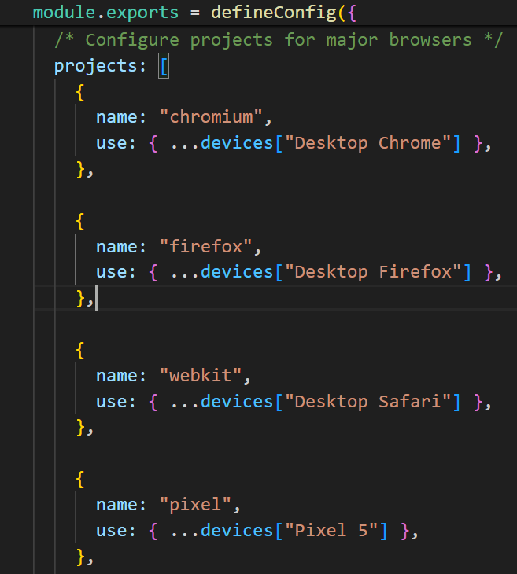
Projects

Slide 412
Use option

Slide 413
Use option
The use object allows you to centralize and manage browser-specific configurations in one place.
This includes settings like browserName, channel, executablePath, viewport, headless, ignoreHTTPSErrors, etc.
By defining these settings within the use object, you ensure consistency across all browser instances used in your tests.

Slide 414
Use config object settings
playwright.config.js
module.exports = {
use: {
browserName: 'chromium',
channel: 'chrome',
viewport: { width: 1280, height: 720 },
headless: false,
},
};

Slide 415
Overriding use option
await page.setViewportSize({ width: 1920, height: 1080 });

Slide 416
HTMl web elements

Slide 417
Text Content

Slide 418
Text Content
<p>: Represents a paragraph of text.
<span>: Inline element used for styling and grouping text.
<h1> to <h6>: Headings of varying sizes (from largest <h1> to smallest <h6>).
<a>: Anchor element for creating hyperlinks.
<strong>: Emphasizes text as important (typically renders as bold).
<em>: Emphasizes text (typically renders as italic).

Slide 419
Form Controls

Slide 420
Form Controls
<input>: Input control for text, password, checkboxes, radio buttons, etc.
type="text": Text input.
type="password": Password input.
type="checkbox": Checkbox input.
type="radio": Radio button input.
Example: <input type="text" name="username“ id=“userId” value=“SomeValue”>
<textarea>: Multiline text input field.
<select>: Dropdown list for selecting options.

Slide 421
Form Controls
<option>: Individual option within a <select> dropdown.
<button>: Button element for triggering actions.
<label>: Label associated with form controls for accessibility.

Slide 422
Multimedia

Slide 423
Multimedia
<img>: Displays an image.
<audio>: Embeds audio content.
<video>: Embeds video content.

Slide 424
Lists

Slide 425
Lists
<ul>: Unordered list.
something
some other thing
last thing
<li>: List item within an unordered or ordered list.
<ol>: Ordered list.
1. something
2. some other thing
3. last thing

Slide 426
Tables

Slide 427
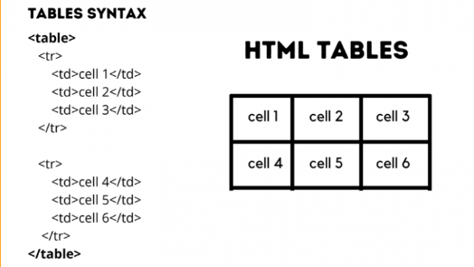
Tables
<table>: Defines a table.
<tr>: Table row.
<td>: Table data/cell in a row.
<th>: Table header cell.

Slide 428
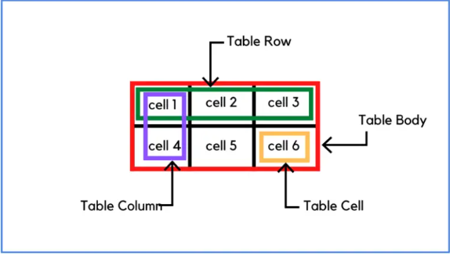
Table Representation
tr = row
td = column

Slide 429
Structural Elements

Slide 430
Structural Elements
<div>: Generic container for grouping and styling elements.
<section>: Represents a section of content.
<article>: Represents an independent piece of content.
<header>: Defines introductory content or header section.
<footer>: Defines footer content or section.

Slide 431
Interactive Elements

Slide 432
Interactive Elements
<button>: Interactive button for triggering actions.
<input type="checkbox">: Checkbox input.
<input type="radio">: Radio button input.
<input type="file">: File upload input.
<input type="range">: Slider control.
<input type="date">: Date picker.

Slide 433
Semantic Markup

Slide 434
Semantic Markup
<nav>: Defines navigation links.
<aside>: Represents content aside from the main content.
<main>: Defines the main content area of a document.
<figure>: Represents self-contained content (e.g., images, illustrations, diagrams).

Slide 435
Miscellaneous

Slide 436
Miscellaneous
<br>: Line break.
<hr>: Horizontal rule (divider line).

Slide 437


Thank you

